Slide 1
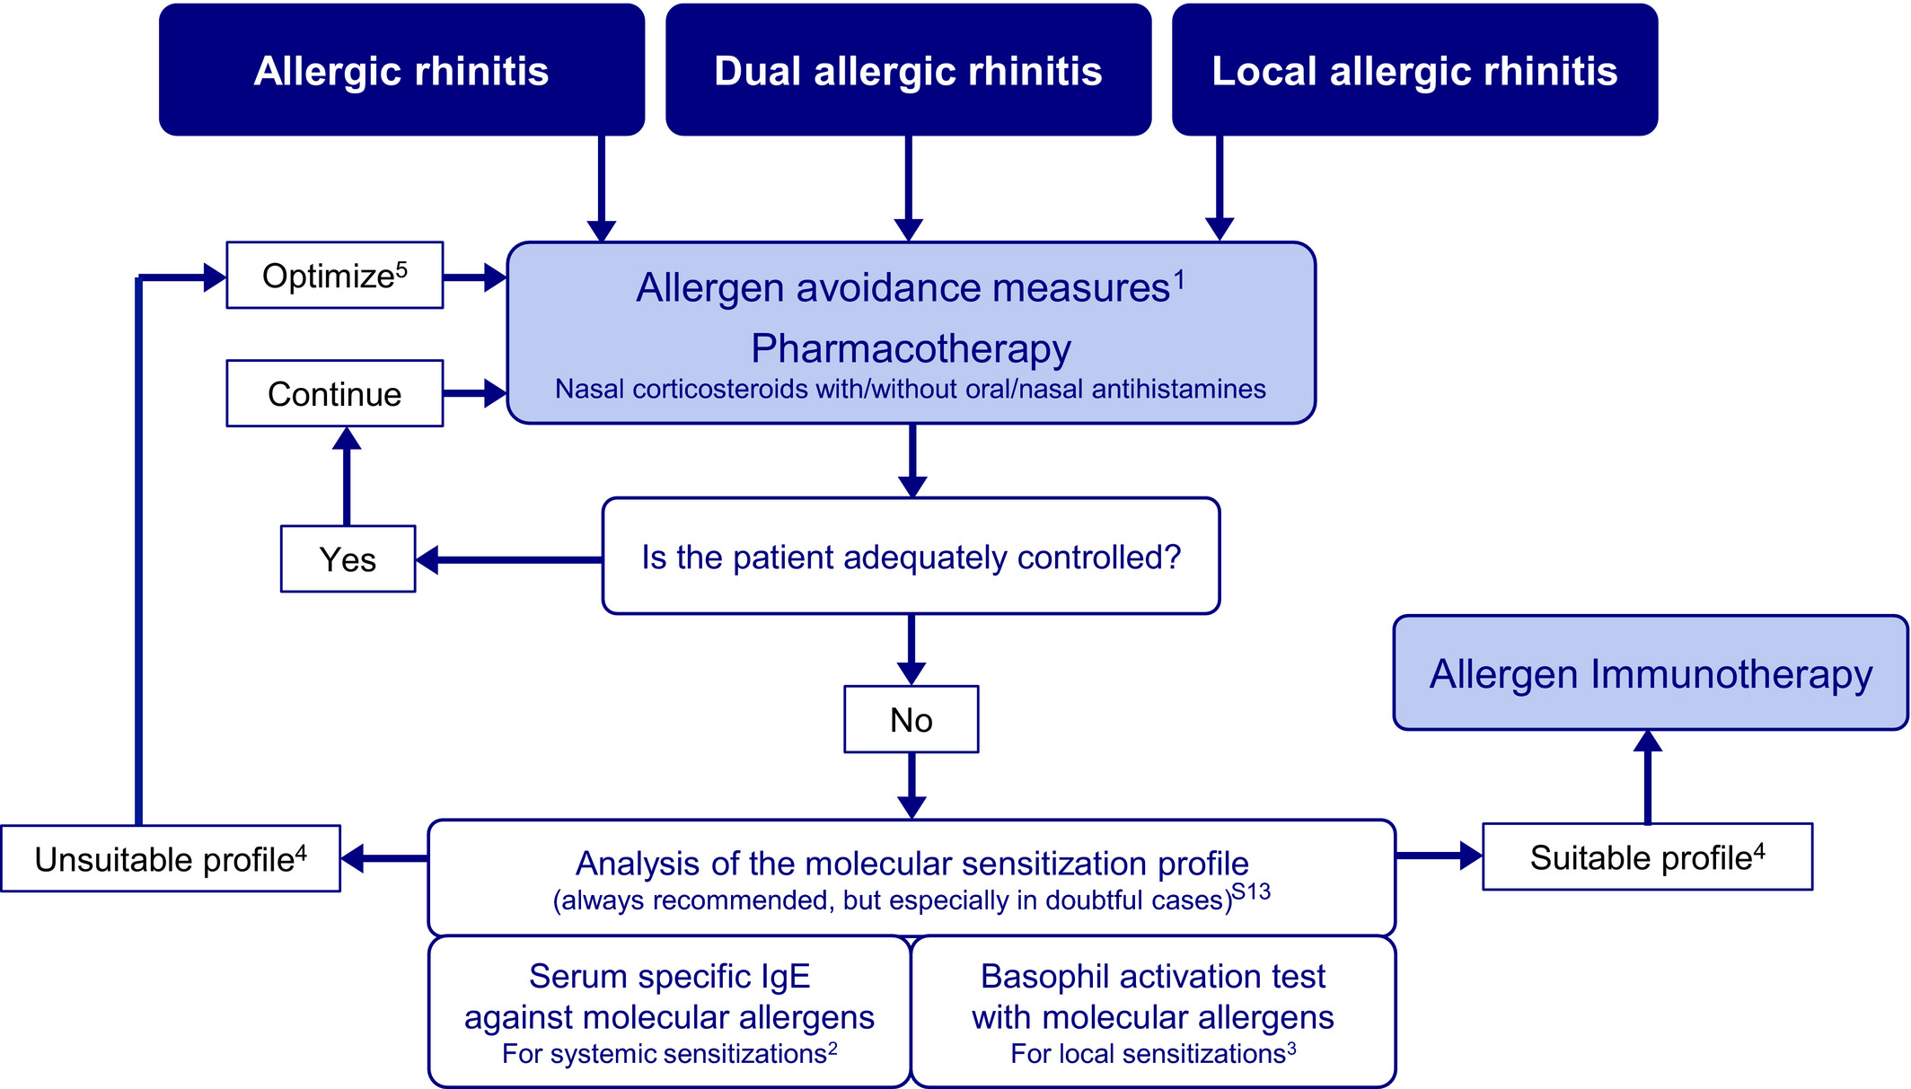
Medical algorithm: Diagnosis and treatment of local allergic rhinitis
Ibon Eguiluz-Gracia, Almudena Testera-Montes, Carmen Rondon
Allergy, Volume: 76, Issue: 9, Pages: 2927-2930, First published: 05 April 2021, DOI: (10.1111/all.14848)
Notes:
Therapeutic algorithm of allergic phenotypes of rhinitis. 1: allergen avoidance measures can be very effective in cases driven by animal epithelia, but are often insufficient for cases driven by pollens, house dust mite or fungi; 2: serum specific IgE against molecular allergens is useful to establish the sensitization profile of dual allergic rhinitis (systemic sensitizations) and allergic rhinitis patients; 3: basophil activation test with molecular allergens is useful to establish the sensitization profile of dual allergic rhinitis (local sensitizations) and local allergic rhinitis patients; 4: sensitization to the major molecular allergens (or to those predominantly represented in allergen immunotherapy products) (eg Phl p 1) of one or of few allergenic sources (eg Phleum pratense) supports the prescription of allergen immunotherapy. Conversely, sensitization to panallergens (eg Phl p 12) or genuine sensitization to several allergenic sources does not support the prescription of allergen immunotherapy; 5: for example by administering azelastine and fluticasone in the same nasal device instead or taking separately oral antihistamines and nasal fluticasone
IF THIS IMAGE HAS BEEN PROVIDED BY OR IS OWNED BY A THIRD PARTY, AS INDICATED IN THE CAPTION LINE, THEN FURTHER PERMISSION MAY BE NEEDED BEFORE ANY FURTHER USE. PLEASE CONTACT WILEY'S PERMISSIONS DEPARTMENT ON PERMISSIONS@WILEY.COM OR USE THE RIGHTSLINK SERVICE BY CLICKING ON THE 'REQUEST PERMISSIONS' LINK ACCOMPANYING THIS ARTICLE. WILEY OR AUTHOR OWNED IMAGES MAY BE USED FOR NON-COMMERCIAL PURPOSES, SUBJECT TO PROPER CITATION OF THE ARTICLE, AUTHOR, AND PUBLISHER.

