Slide 1
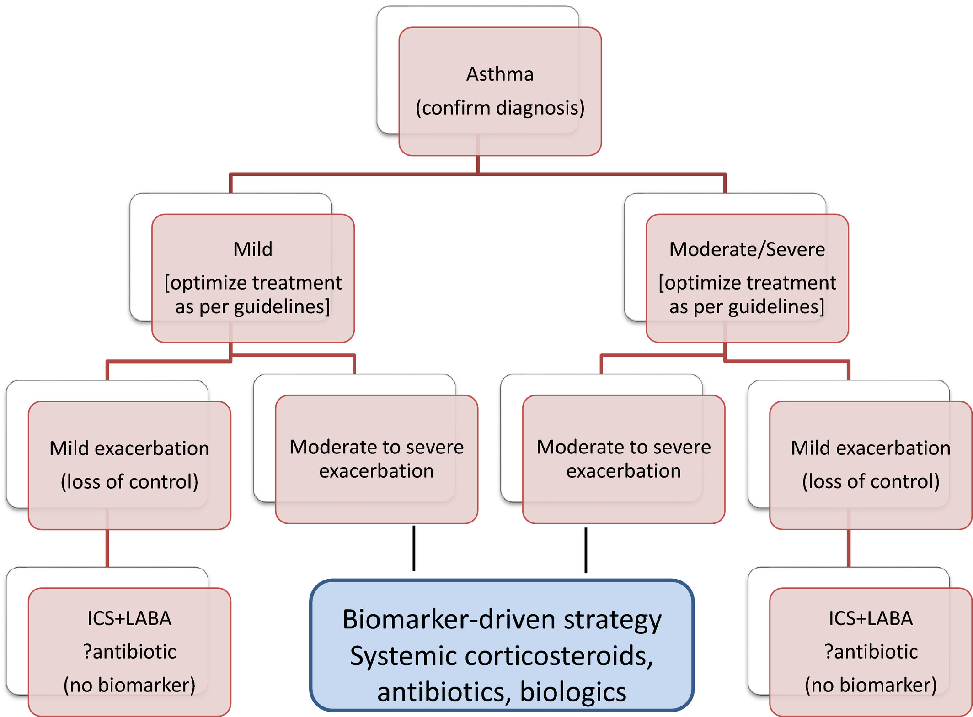
Medical algorithms: Approach to adult asthma exacerbations
Parameswaran Nair, Paul M. O’Byrne
Allergy, Volume: 76, Issue: 11, Pages: 3556-3559, First published: 04 June 2021, DOI: (10.1111/all.14976)
Notes:
Algorithm to manage exacerbations. The first step would be to confirm that symptoms are indeed due to asthma (ie, variable airflow obstruction). After assessing level of control (based on symptoms), and severity (based on intensity of anti‐inflammatory treatment and bronchodilators required to maintain control), treatment would depend on the severity of exacerbations, as recommended by international guidelines. While mild exacerbations (loss of asthma control) may be treated by escalating the dose of maintenance ICS and LABA, (or adding LAMA or SAMA) (and may not require any biomarkers), more severe exacerbations (independent of the severity of asthma) are probably best guided by biomarkers such as blood or sputum eosinophils and exhaled nitric oxide. In future, precision medicine is likely to evolve handprints of specific inflammatory pathways that might be targeted in individual patients. LABA, long‐acting beta‐adrenergic agonists; LAMA, long‐acting muscarinic antagonist; SAMA, short‐acting muscarinic antagonist
IF THIS IMAGE HAS BEEN PROVIDED BY OR IS OWNED BY A THIRD PARTY, AS INDICATED IN THE CAPTION LINE, THEN FURTHER PERMISSION MAY BE NEEDED BEFORE ANY FURTHER USE. PLEASE CONTACT WILEY'S PERMISSIONS DEPARTMENT ON PERMISSIONS@WILEY.COM OR USE THE RIGHTSLINK SERVICE BY CLICKING ON THE 'REQUEST PERMISSIONS' LINK ACCOMPANYING THIS ARTICLE. WILEY OR AUTHOR OWNED IMAGES MAY BE USED FOR NON-COMMERCIAL PURPOSES, SUBJECT TO PROPER CITATION OF THE ARTICLE, AUTHOR, AND PUBLISHER.

