Slide 1
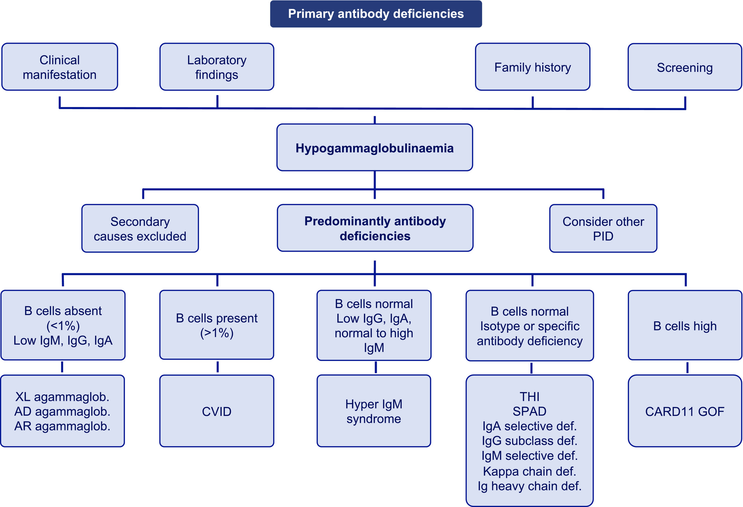
Medical algorithm: Diagnosis and management of antibody immunodeficiencies
Anna Šedivá, Tomáš Milota, Jiří Litzman, Isabella Quinti, Isabelle Meyts, et al.
Allergy, Volume: 76, Issue: 12, Pages: 3841-3844, First published: 26 May 2021, DOI: (10.1111/all.14961)
Notes:
Diagnostic algorithm for antibody deficiency. PAD, Primary antibody deficiency; CVID, Common variable immunodeficiency; THI, Transient hypogammaglobulinaemia of infancy; SPAD, Specific antibody deficiency; XL, X‐linked; AD, Autosomal dominant; AR, Autosomal recessive; GOF, Gain‐of‐function
IF THIS IMAGE HAS BEEN PROVIDED BY OR IS OWNED BY A THIRD PARTY, AS INDICATED IN THE CAPTION LINE, THEN FURTHER PERMISSION MAY BE NEEDED BEFORE ANY FURTHER USE. PLEASE CONTACT WILEY'S PERMISSIONS DEPARTMENT ON PERMISSIONS@WILEY.COM OR USE THE RIGHTSLINK SERVICE BY CLICKING ON THE 'REQUEST PERMISSIONS' LINK ACCOMPANYING THIS ARTICLE. WILEY OR AUTHOR OWNED IMAGES MAY BE USED FOR NON-COMMERCIAL PURPOSES, SUBJECT TO PROPER CITATION OF THE ARTICLE, AUTHOR, AND PUBLISHER.

