Slide 1
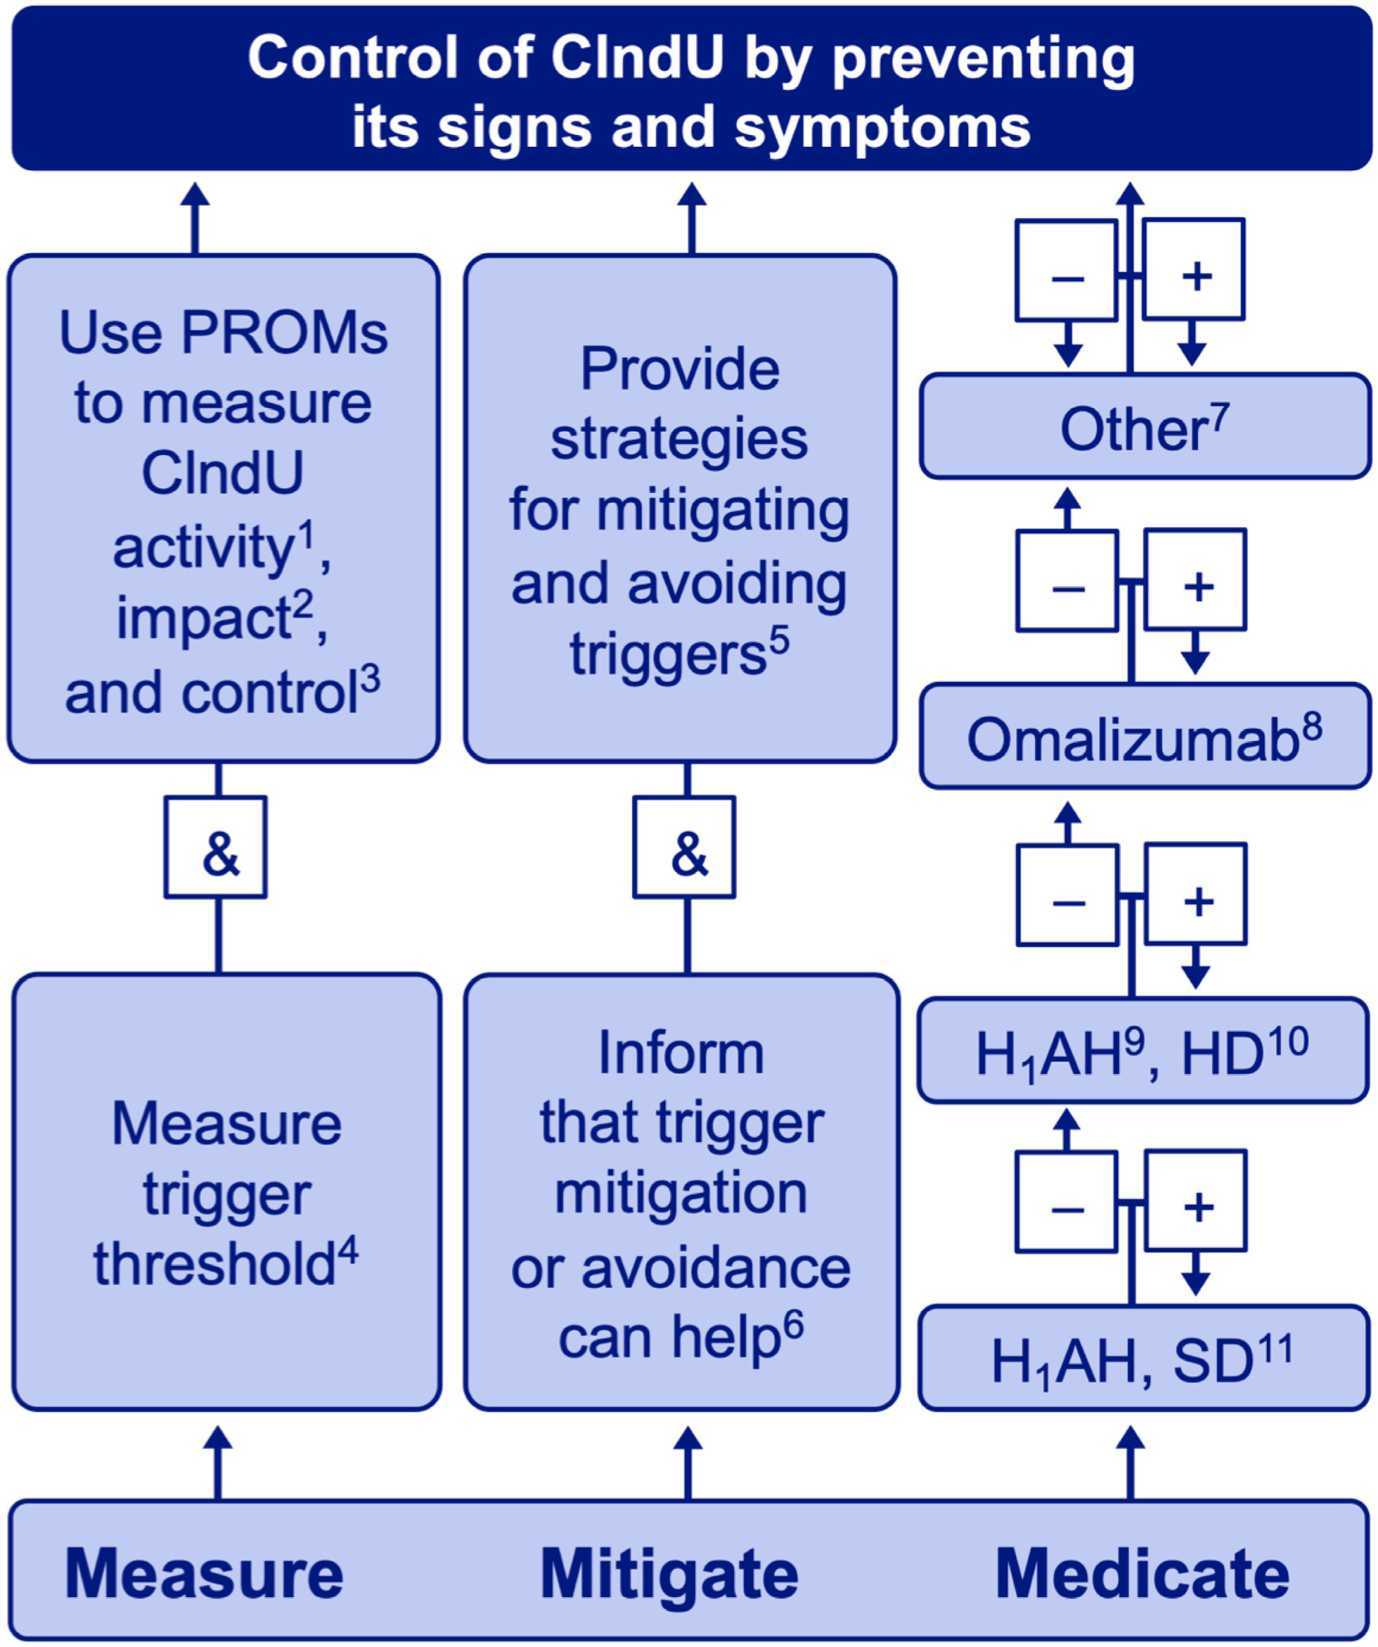
Diagnosis and treatment of chronic inducible urticaria
Marcus Maurer, Tomasz Hawro, Karoline Krause,Markus Magerl, Martin Metz, et al.
Allergy, Volume: 74, Issue: 12, Pages: 2550-2553, First published: 18 May 2019, DOI: (10.1111/all.13878)
Notes:
The three Ms of managing chronic inducible urticaria (CIndU): Measure, Mitigate, and Medicate. The goal of managing CIndU is to achieve control of the disease by preventing its signs and symptoms until spontaneous remission occurs. This is done by measuring and monitoring disease activity, impact, and control, by mitigating the effects of triggers, and by the prophylactic use of medication. Abbreviations: PROMs, patient‐reported outcome measures, H1AH, H1 antihistamine; SD, standard dose; HD, high dose. 1Disease activity should be assessed by the use of standardized tools where available, for example, the CholUAS7 in cholinergic urticaria; 2Disease impact should be measured by instruments that assess disease‐specific quality‐of‐life impairment such as the CholU‐QoL for cholinergic urticaria; 3Disease control, in all CIndUs, should be assessed with the urticaria control test; 4Trigger thresholds should be assessed using recommended protocols and instruments; 5Patients should be provided with examples of how they can modify or avoid exposure to relevant triggers; 6Patients should know that trigger mitigation and avoidance can help. On the other hand, quality of life should not be impaired by this; 7Treatments other than omalizumab and antihistamines can be effective in some or all CIndUs. These include trigger desensitization therapy; 8Omalizumab can be of benefit in all CIndUs and has been shown, in randomized controlled trials, to be effective in cold urticaria and symptomatic dermographism. As of now, omalizumab is licensed for the treatment of patients with CSU, but not CIndU. 9Modern nonsedating antihistamines should be preferred over older sedating ones; 10Higher than standard doses (up to fourfold the standard dose) have been shown to be more effective than standard doses of antihistamines in the management of CIndU; 11Antihistamines, in the management of CIndU, should be used daily
IF THIS IMAGE HAS BEEN PROVIDED BY OR IS OWNED BY A THIRD PARTY, AS INDICATED IN THE CAPTION LINE, THEN FURTHER PERMISSION MAY BE NEEDED BEFORE ANY FURTHER USE. PLEASE CONTACT WILEY'S PERMISSIONS DEPARTMENT ON PERMISSIONS@WILEY.COM OR USE THE RIGHTSLINK SERVICE BY CLICKING ON THE 'REQUEST PERMISSIONS' LINK ACCOMPANYING THIS ARTICLE. WILEY OR AUTHOR OWNED IMAGES MAY BE USED FOR NON-COMMERCIAL PURPOSES, SUBJECT TO PROPER CITATION OF THE ARTICLE, AUTHOR, AND PUBLISHER.

