Slide 1
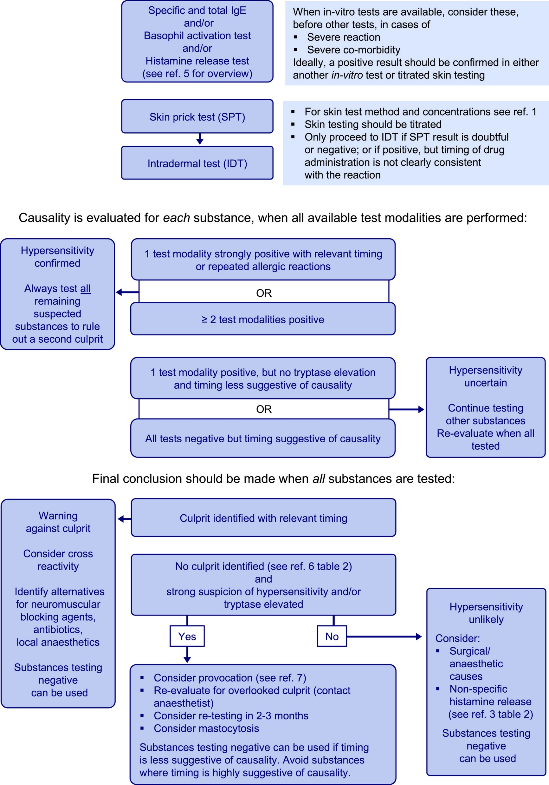
Medical algorithms: Diagnosis and investigation of perioperative immediate hypersensitivity reactions
Lene H. Garvey, Birgitte Bech Melchiors, Didier G. Ebo, Paul-Michel Mertes, Mogens Krøigaard
Allergy, Volume: 75, Issue: 8, Pages: 2139-2142, First published: 03 January 2020, DOI: (10.1111/all.14226)
Notes:
Management algorithm for the preschool child presenting with wheezing/asthma
IF THIS IMAGE HAS BEEN PROVIDED BY OR IS OWNED BY A THIRD PARTY, AS INDICATED IN THE CAPTION LINE, THEN FURTHER PERMISSION MAY BE NEEDED BEFORE ANY FURTHER USE. PLEASE CONTACT WILEY'S PERMISSIONS DEPARTMENT ON PERMISSIONS@WILEY.COM OR USE THE RIGHTSLINK SERVICE BY CLICKING ON THE 'REQUEST PERMISSIONS' LINK ACCOMPANYING THIS ARTICLE. WILEY OR AUTHOR OWNED IMAGES MAY BE USED FOR NON-COMMERCIAL PURPOSES, SUBJECT TO PROPER CITATION OF THE ARTICLE, AUTHOR, AND PUBLISHER.

