Slide 1
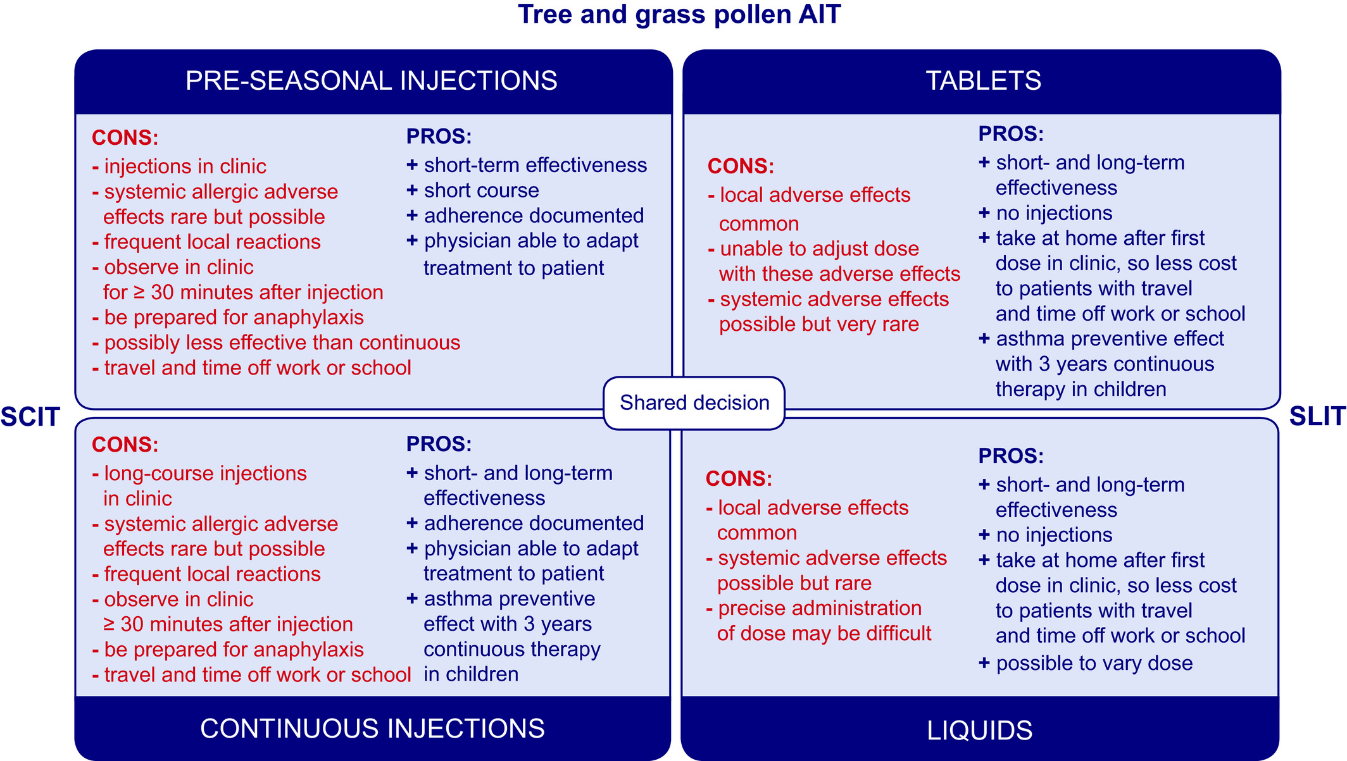
Algorithms in allergen immunotherapy in allergic rhinoconjunctivitis
Oliver Pfaar, Elizabeth Angier, Antonella Muraro, Susanne Halken, Graham Roberts
Allergy, Volume: 75, Issue: 9, Pages: 2411-2414, First published: 12 March 2020, DOI: (10.1111/all.14270)
Notes:
Deciding which tree and grass pollen AIT to start for which patient
IF THIS IMAGE HAS BEEN PROVIDED BY OR IS OWNED BY A THIRD PARTY, AS INDICATED IN THE CAPTION LINE, THEN FURTHER PERMISSION MAY BE NEEDED BEFORE ANY FURTHER USE. PLEASE CONTACT WILEY'S PERMISSIONS DEPARTMENT ON PERMISSIONS@WILEY.COM OR USE THE RIGHTSLINK SERVICE BY CLICKING ON THE 'REQUEST PERMISSIONS' LINK ACCOMPANYING THIS ARTICLE. WILEY OR AUTHOR OWNED IMAGES MAY BE USED FOR NON-COMMERCIAL PURPOSES, SUBJECT TO PROPER CITATION OF THE ARTICLE, AUTHOR, AND PUBLISHER.

