Slide 1
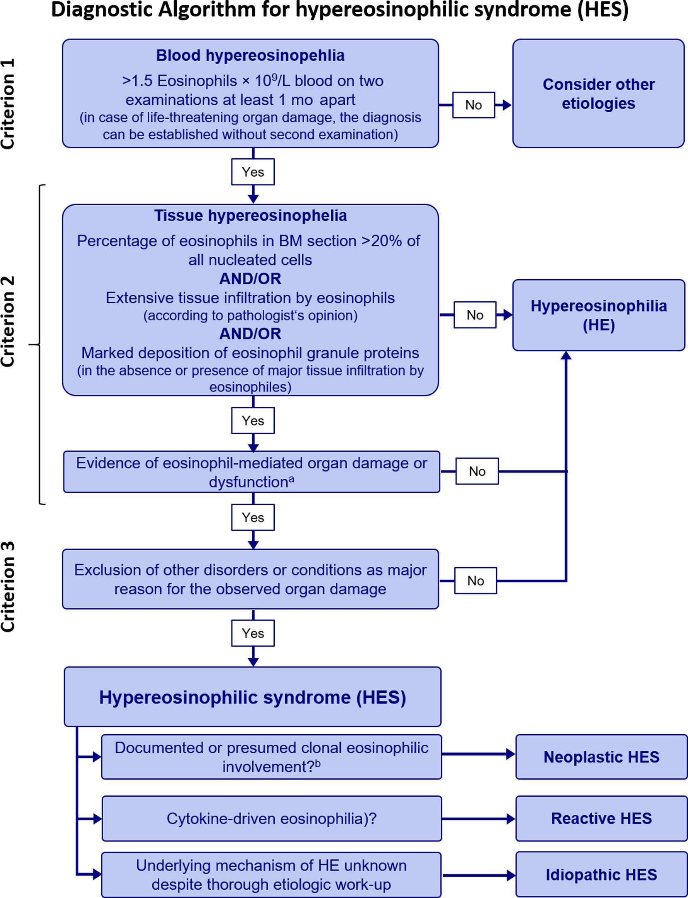
Medical algorithm: Diagnosis and treatment of hypereosinophilic syndrome
Barbara Schuster, Alexander Zink, Kilian Eyerich
Allergy, Volume: 75, Issue: 11, Pages: 3003-3006, First published: 16 May 2020, DOI: (10.1111/all.14368)
Notes:
Medical algorithm for the diagnosis of hypereosinophilic syndrome (HES). aAt least one of the following conditions must be present: (a) fibrosis (lung, heart, digestive tract, skin, and others), (b) thrombosis, (c) cutaneous or mucosal erythema, (angio) edema, ulceration, pruritus, or eczema, and/or (d) peripheral or central neuropathy with chronic or recurrent neurologic deficit. bGenetic abnormality known to cause clonal eosinophilia (eg, rearrangement of PDGFRA, PDGFRB, FGFR1, or PCM‐JAK2) and/or ≥4 of the following features: dysplastic eosinophils, elevated serum vitamin B12 and/or tryptase levels, anemia and/or thrombocytopenia, splenomegaly, bone marrrow cellularity >80%, myelofibrosis, atypical mastcells; and/or strong clinical suspicion of a myeloproliferative disorder
IF THIS IMAGE HAS BEEN PROVIDED BY OR IS OWNED BY A THIRD PARTY, AS INDICATED IN THE CAPTION LINE, THEN FURTHER PERMISSION MAY BE NEEDED BEFORE ANY FURTHER USE. PLEASE CONTACT WILEY'S PERMISSIONS DEPARTMENT ON PERMISSIONS@WILEY.COM OR USE THE RIGHTSLINK SERVICE BY CLICKING ON THE 'REQUEST PERMISSIONS' LINK ACCOMPANYING THIS ARTICLE. WILEY OR AUTHOR OWNED IMAGES MAY BE USED FOR NON-COMMERCIAL PURPOSES, SUBJECT TO PROPER CITATION OF THE ARTICLE, AUTHOR, AND PUBLISHER.

