Slide 1
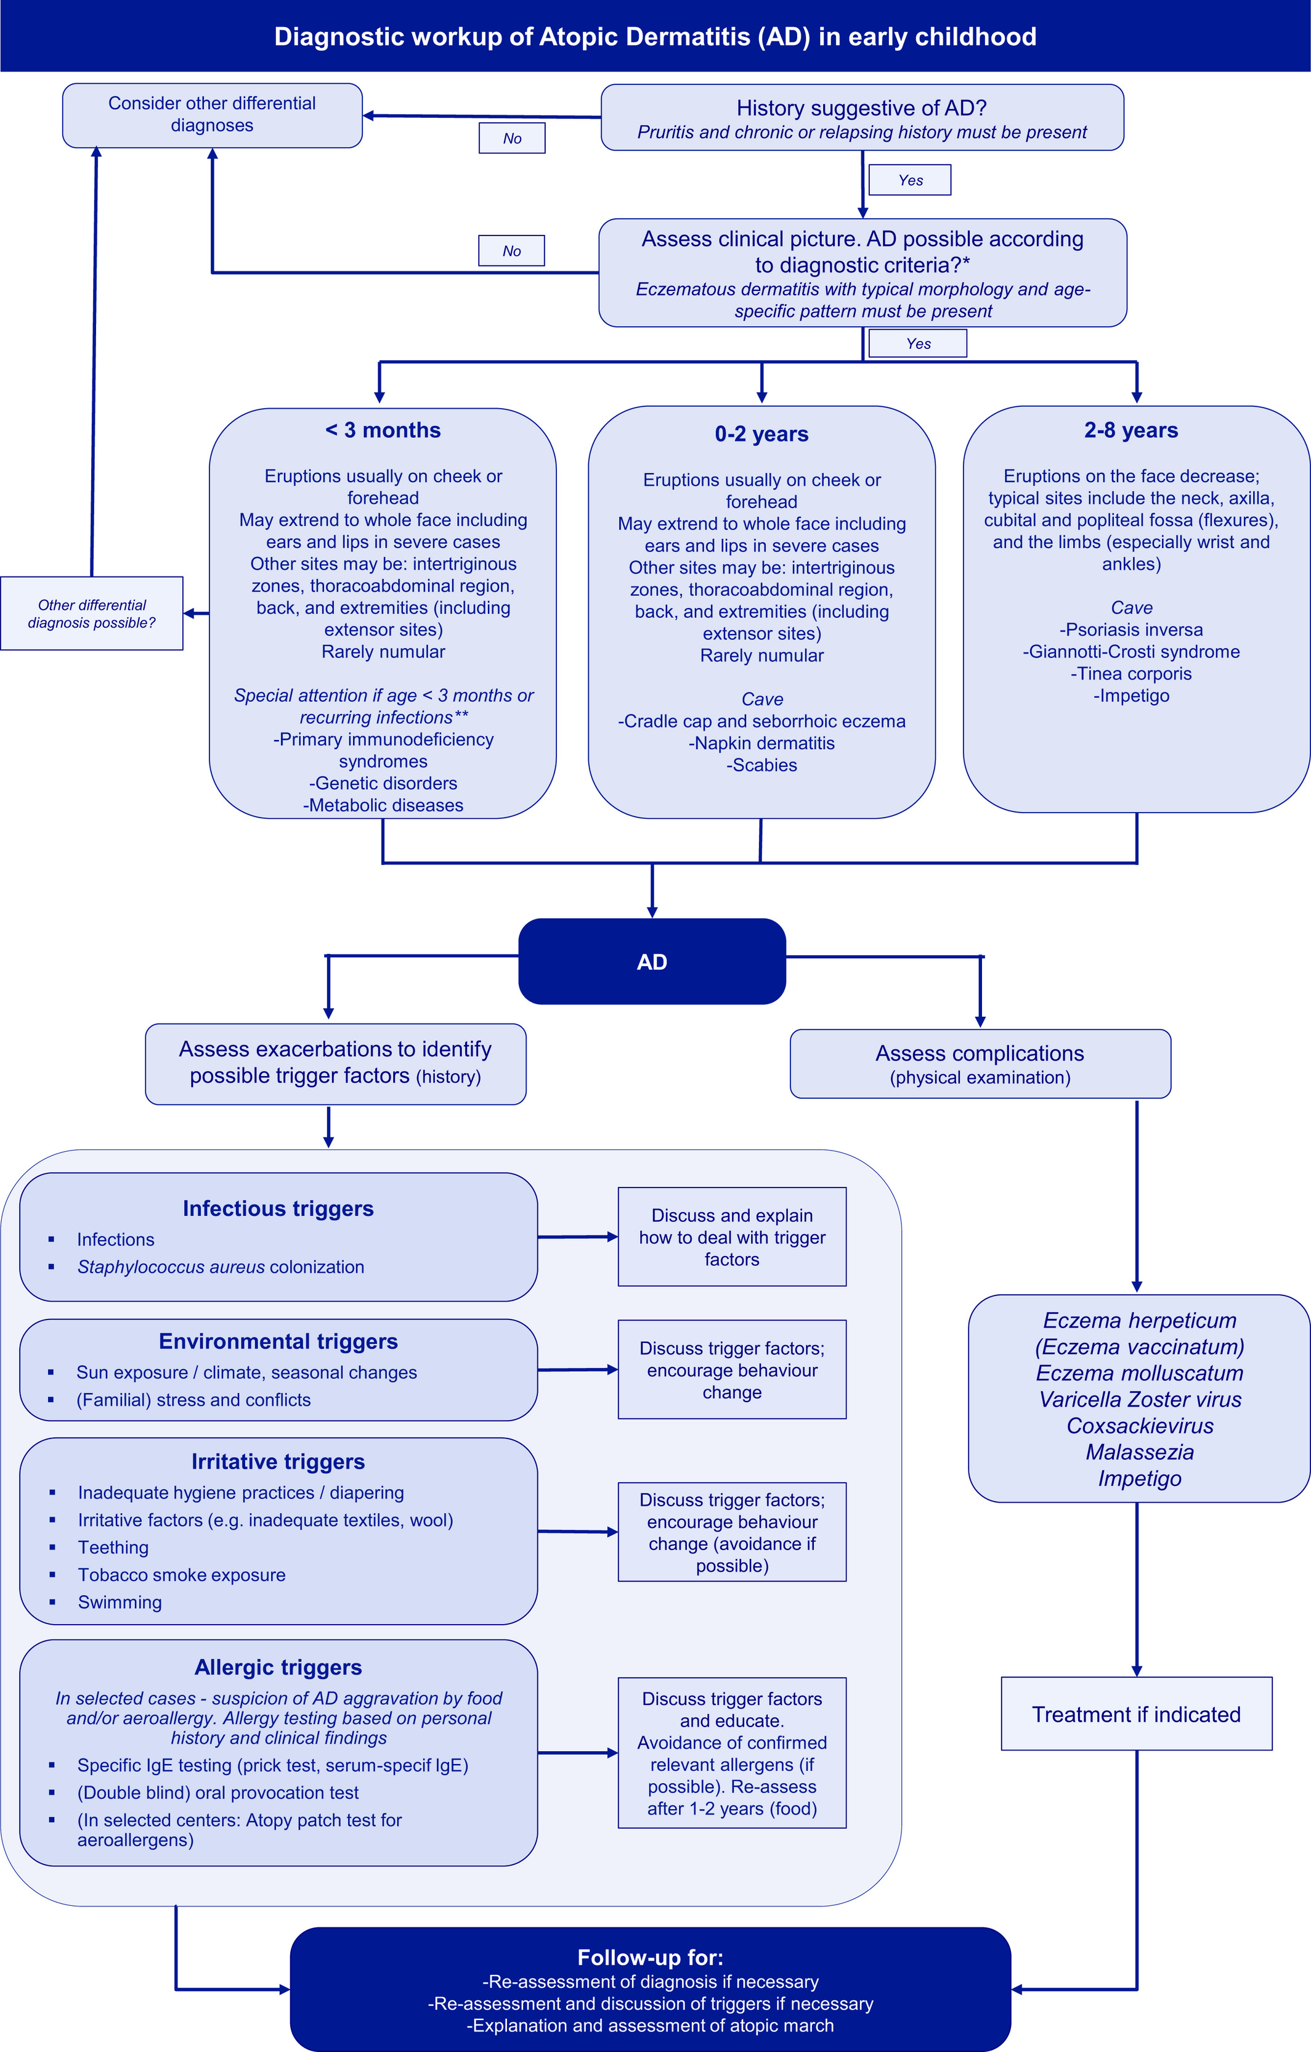
Medical algorithm: Diagnosis of atopic dermatitis in early childhood (part I)
Sherief R. Janmohamed, Martine Grosber, Lawrence F. Eichenfield, Johannes Ring, Jan Gutermuth
Allergy, Volume: 76, Issue: 1, Pages: 403-406, First published: 22 October 2020, DOI: (10.1111/all.14638)
Notes:
Medical algorithm for the diagnosis of atopic dermatitis (AD) in early childhood. *For diagnostic criteria, Hanifin and Rajka's criteria, the United Kingdom (UK) Working Party's criteria, the American Academy of Dermatology (AAD) consensus criteria, or other criteria can be used. As a minimum, pruritus, eczematous dermatitis with typical morphology and age‐specific patterns, and chronic or relapsing history must be present. **In early‐onset severe AD (<3 months), certain primary immunodeficiency syndromes such as Omenn syndrome, selective IgA deficiency, hyper‐IgE syndromes, and Wiskott‐Aldrich syndrome, genetic disorders with an impaired barrier function, such as Comel‐Netherton syndrome and peeling skin syndrome, and some inherited metabolic diseases such as biotin deficiency or phenylketonuria should be considered as differential diagnoses
IF THIS IMAGE HAS BEEN PROVIDED BY OR IS OWNED BY A THIRD PARTY, AS INDICATED IN THE CAPTION LINE, THEN FURTHER PERMISSION MAY BE NEEDED BEFORE ANY FURTHER USE. PLEASE CONTACT WILEY'S PERMISSIONS DEPARTMENT ON PERMISSIONS@WILEY.COM OR USE THE RIGHTSLINK SERVICE BY CLICKING ON THE 'REQUEST PERMISSIONS' LINK ACCOMPANYING THIS ARTICLE. WILEY OR AUTHOR OWNED IMAGES MAY BE USED FOR NON-COMMERCIAL PURPOSES, SUBJECT TO PROPER CITATION OF THE ARTICLE, AUTHOR, AND PUBLISHER.

