Slide 1
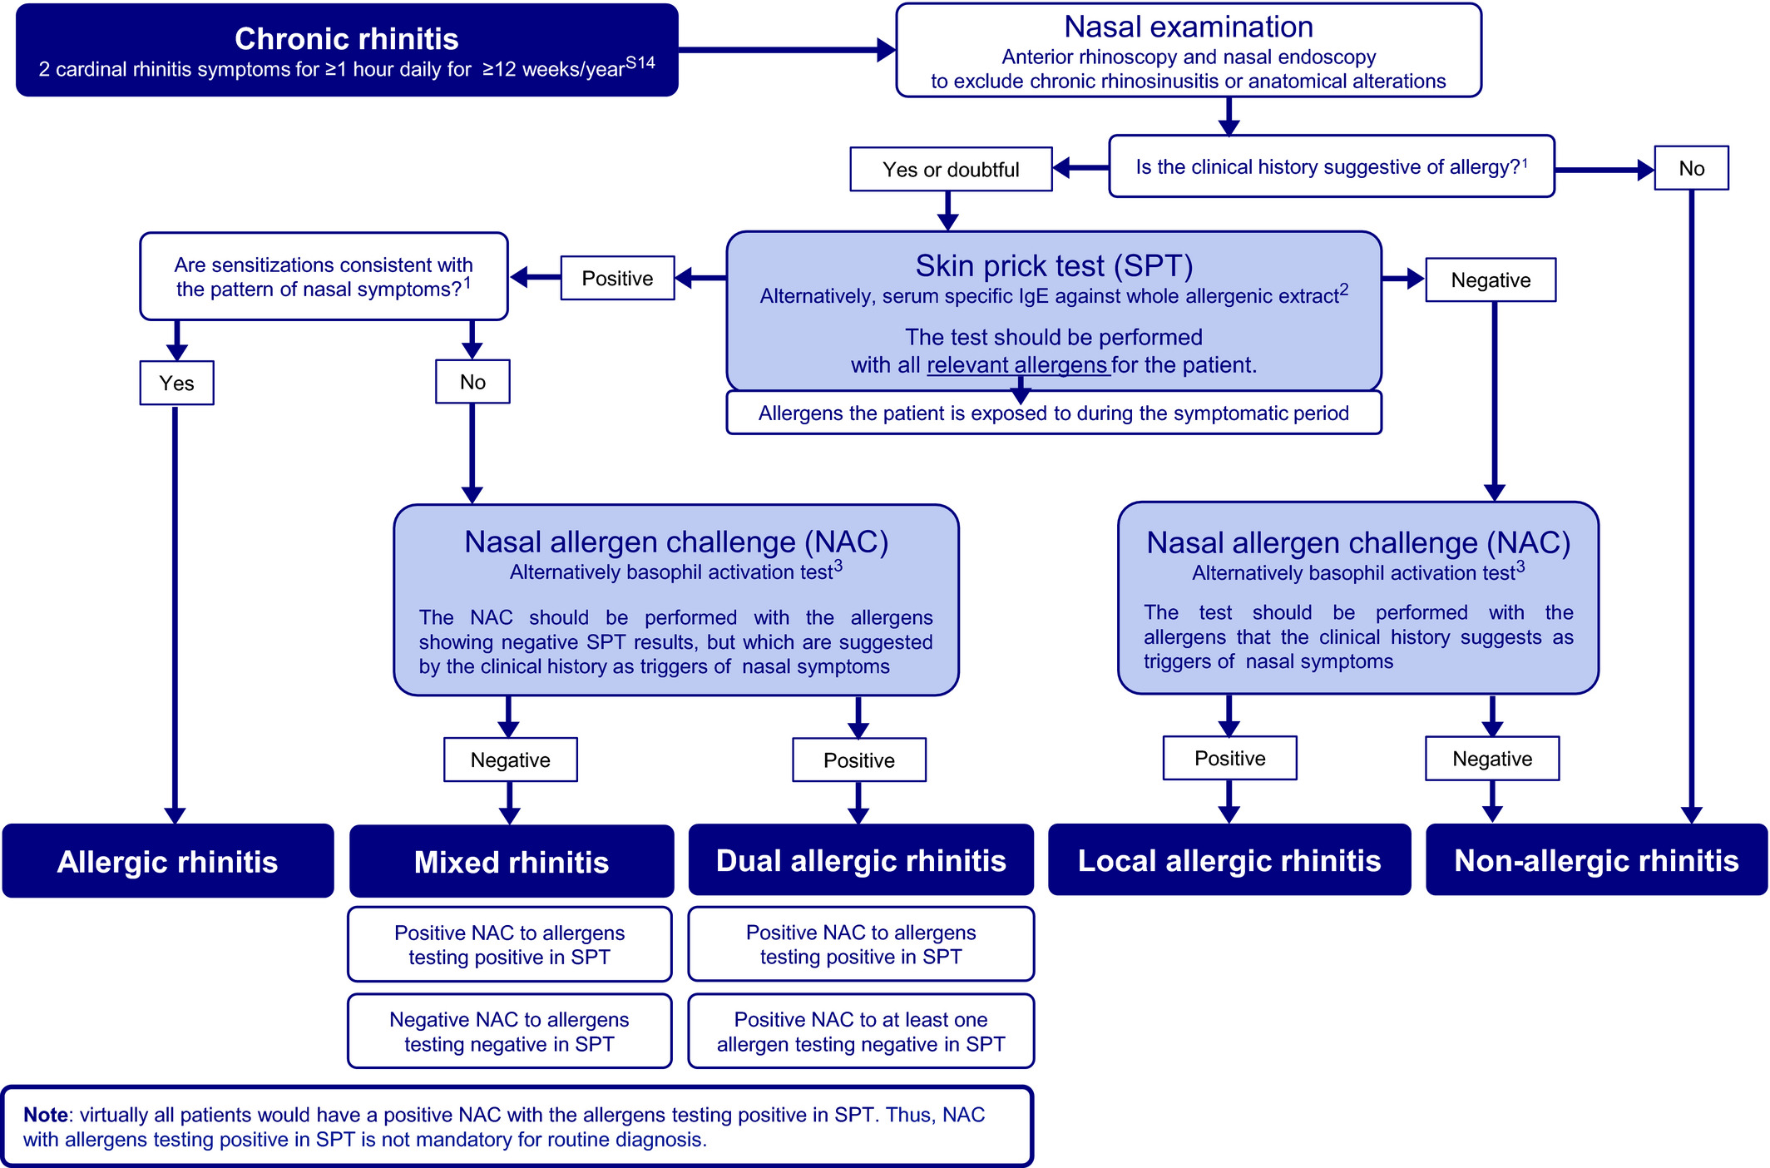
Medical algorithm: Diagnosis and treatment of local allergic rhinitis
Ibon Eguiluz-Gracia, Almudena Testera-Montes, Carmen Rondon
Allergy, Volume: 76, Issue: 9, Pages: 2927-2930, First published: 05 April 2021, DOI: (10.1111/all.14848)
Notes:
Diagnostic algorithm of chronic rhinitis. 1: In order to assess for the concordance between systemic sensitizations and the pattern of nasal symptoms, or to evaluate whether the clinical history is suggestive of allergic disease, it is important to interrogate the patient about the seasonality and the specific triggers (exposure to vegetation, house dust, furry animals, etc.) of the nasal symptoms; 2: the sensitivity of skin prick test (SPT) to detect systemic sensitizations is superior to that of serum specific (s)IgE against whole allergenic sources (eg Phleum pratense) (reference S2). Moreover, SPT is a cheaper and quicker method; 3: the performance of a basophil activation test (BAT) can be considered when the nasal allergen challenge is contraindicated (eg pregnancy, severe uncontrolled asthma, etc.), or when it cannot be conducted for human or technical reasons. Nevertheless, although >50% of LAR and DAR patients test positive in the BAT, a negative result does not exclude the diagnosis of local airway allergy
IF THIS IMAGE HAS BEEN PROVIDED BY OR IS OWNED BY A THIRD PARTY, AS INDICATED IN THE CAPTION LINE, THEN FURTHER PERMISSION MAY BE NEEDED BEFORE ANY FURTHER USE. PLEASE CONTACT WILEY'S PERMISSIONS DEPARTMENT ON PERMISSIONS@WILEY.COM OR USE THE RIGHTSLINK SERVICE BY CLICKING ON THE 'REQUEST PERMISSIONS' LINK ACCOMPANYING THIS ARTICLE. WILEY OR AUTHOR OWNED IMAGES MAY BE USED FOR NON-COMMERCIAL PURPOSES, SUBJECT TO PROPER CITATION OF THE ARTICLE, AUTHOR, AND PUBLISHER.

