Slide 1
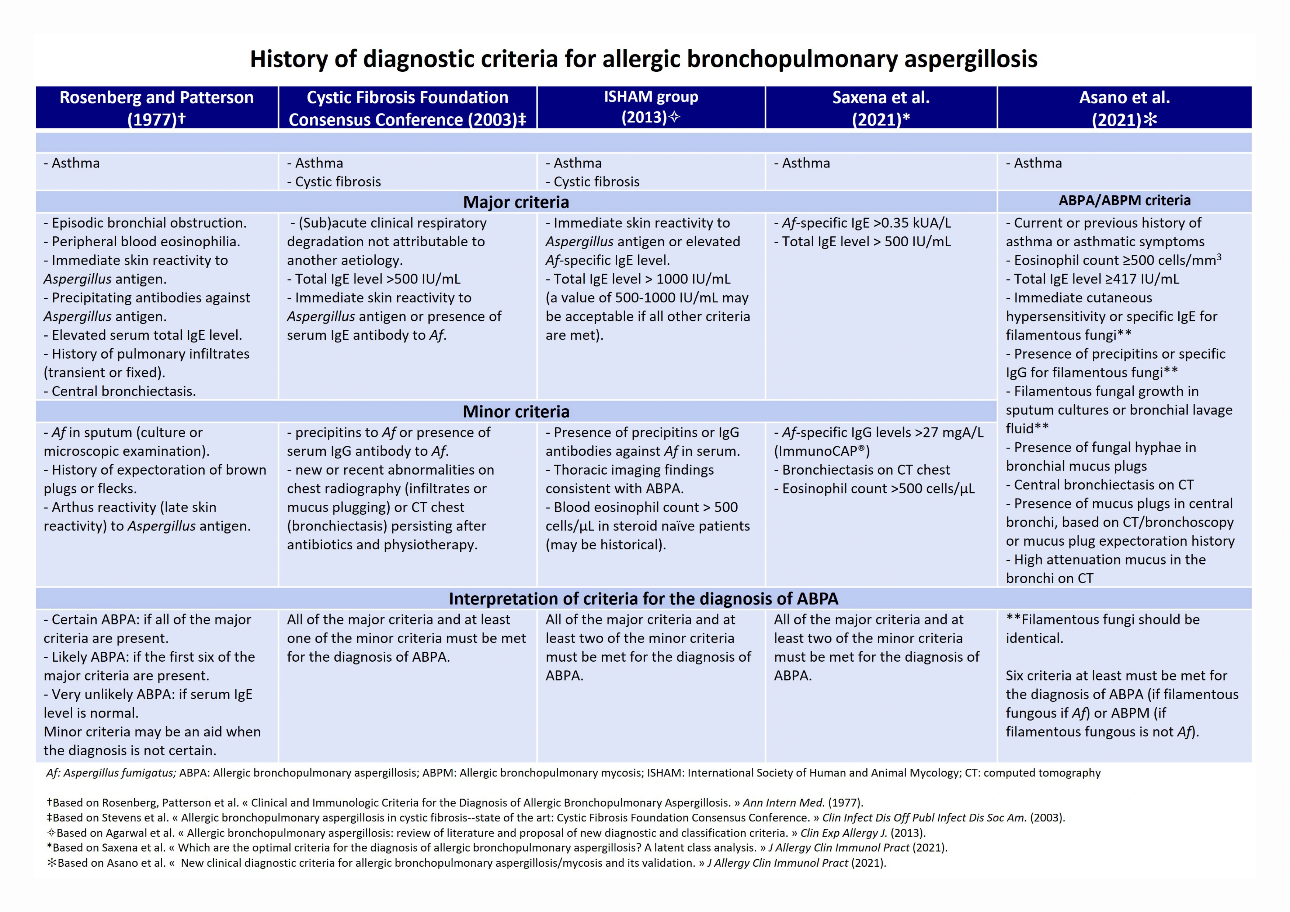
Medical algorithms: Approach to adult asthma exacerbations Parameswaran Nair, Paul M. O’Byrne
Allergy, Volume: 76, Issue: 11, Pages: 3556-3559, First published: 26 May 2021, DOI: (10.1111/all.14976)
Notes:
Therapeutic algorithm for antibody deficiency. ATB, Antibiotics; IgRT, Immunoglobulin replacement therapy; AI, Autoimmune; GLILD, Granulomatous‐lymphocytic interstitial lung disease; IBD, Inflammatory bowel disease; LN, Lymph node
IF THIS IMAGE HAS BEEN PROVIDED BY OR IS OWNED BY A THIRD PARTY, AS INDICATED IN THE CAPTION LINE, THEN FURTHER PERMISSION MAY BE NEEDED BEFORE ANY FURTHER USE. PLEASE CONTACT WILEY'S PERMISSIONS DEPARTMENT ON PERMISSIONS@WILEY.COM OR USE THE RIGHTSLINK SERVICE BY CLICKING ON THE 'REQUEST PERMISSIONS' LINK ACCOMPANYING THIS ARTICLE. WILEY OR AUTHOR OWNED IMAGES MAY BE USED FOR NON-COMMERCIAL PURPOSES, SUBJECT TO PROPER CITATION OF THE ARTICLE, AUTHOR, AND PUBLISHER.

