Slide 1
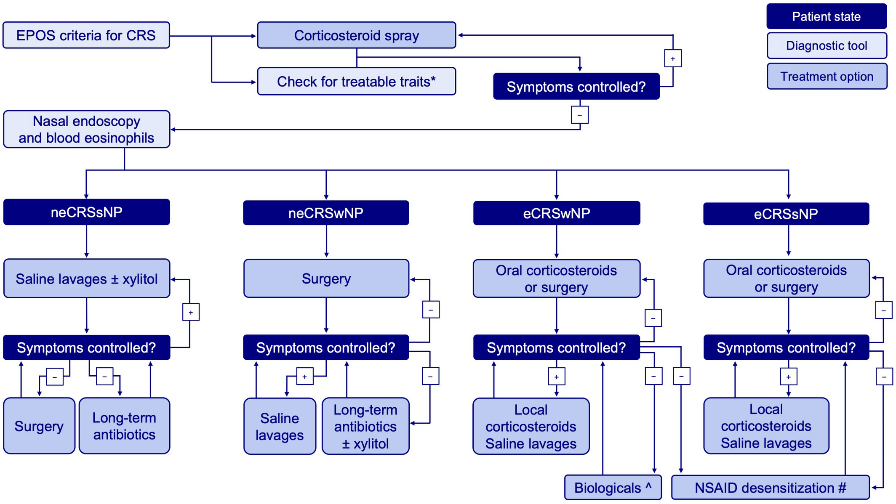
Medical algorithms: Management of chronic rhinosinusitis
Wytske J. Fokkens, Sietze Reitsma
Allergy, Volume: 74, Issue: 7, Pages: 1415-1416, First published: 27 March 2019, DOI: (10.1111/all.13797)
Notes:
EPOS: European position paper on rhinosinusitis and nasal polyps; CRS: chronic rhinosinusitis; (low)eCRS: (low)eosinophilic CRS; sNP: without nasal polyps; wNP: with nasal polyps; NSAID: nonsteroidal anti‐inflammatory drugs. *Treatable traits: smoking, allergy, occupation and mucociliary clearance deficits. ^Biologicals can be considered but additional criteria for this exist in most countries. #NSAID desensitization should only be considered after a positive provocation in patients, without contraindications for long‐term use of high doses of aspirin [Colour figure can be viewed at wileyonlinelibrary.com]
IF THIS IMAGE HAS BEEN PROVIDED BY OR IS OWNED BY A THIRD PARTY, AS INDICATED IN THE CAPTION LINE, THEN FURTHER PERMISSION MAY BE NEEDED BEFORE ANY FURTHER USE. PLEASE CONTACT WILEY'S PERMISSIONS DEPARTMENT ON PERMISSIONS@WILEY.COM OR USE THE RIGHTSLINK SERVICE BY CLICKING ON THE 'REQUEST PERMISSIONS' LINK ACCOMPANYING THIS ARTICLE. WILEY OR AUTHOR OWNED IMAGES MAY BE USED FOR NON-COMMERCIAL PURPOSES, SUBJECT TO PROPER CITATION OF THE ARTICLE, AUTHOR, AND PUBLISHER.

