Slide 1
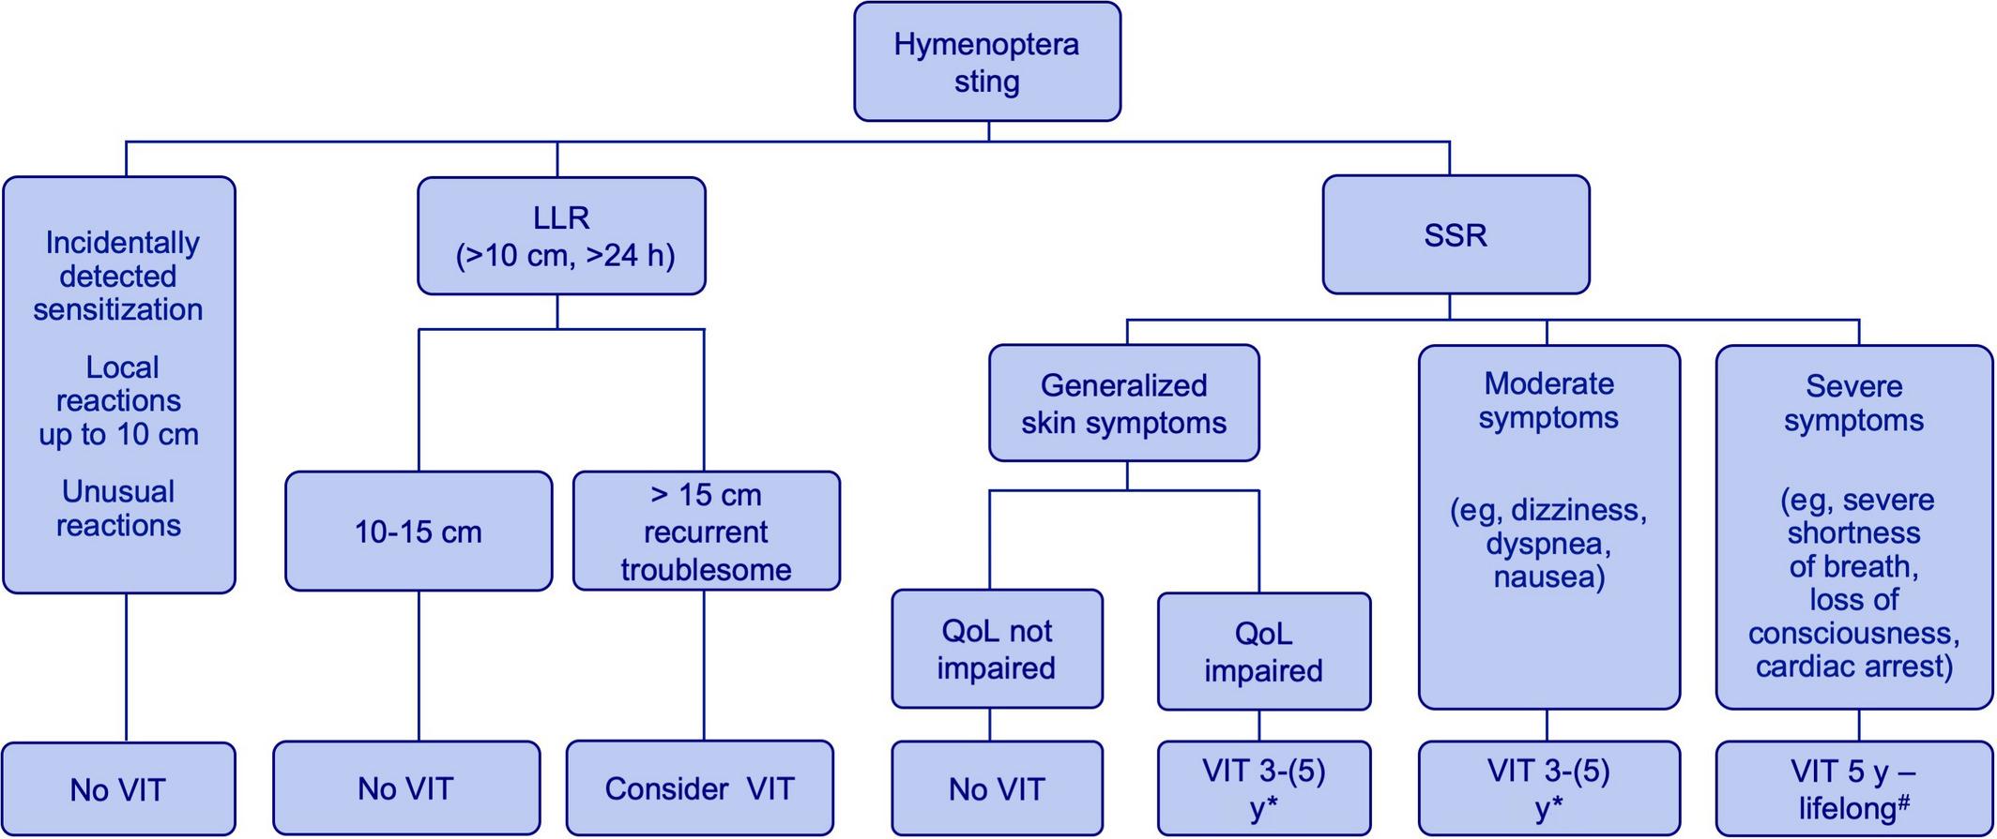
Medical Algorithms: Diagnosis and treatment of Hymenoptera venom allergy
Gunter J. Sturm, Lisa Arzt-Gradwohl, Eva- M. Varga
Allergy, Volume: 74, Issue: 10, Pages: 2016-2018, First published: 11 April 2019, DOI: (10.1111/all.13817)
Notes:
Treatment algorithm based on EAACI guidelines on venom immunotherapy. *Consider special conditions: Cardiovascular and organ‐specific autoimmune diseases must be stable; ACE inhibitor and/or beta‐blocker therapy may be continued if required but patients must be informed about potential risks; VIT contraindications: malignant disease; multisystem autoimmune disease; children < 5 y; pregnancy. #VIT can also be performed in patients with remission of a malignant disease and children < 5 y, when child is likely to be cooperative. In children, treatment over 3‐5 y may be sufficient.
IF THIS IMAGE HAS BEEN PROVIDED BY OR IS OWNED BY A THIRD PARTY, AS INDICATED IN THE CAPTION LINE, THEN FURTHER PERMISSION MAY BE NEEDED BEFORE ANY FURTHER USE. PLEASE CONTACT WILEY'S PERMISSIONS DEPARTMENT ON PERMISSIONS@WILEY.COM OR USE THE RIGHTSLINK SERVICE BY CLICKING ON THE 'REQUEST PERMISSIONS' LINK ACCOMPANYING THIS ARTICLE. WILEY OR AUTHOR OWNED IMAGES MAY BE USED FOR NON-COMMERCIAL PURPOSES, SUBJECT TO PROPER CITATION OF THE ARTICLE, AUTHOR, AND PUBLISHER.

