Slide 1
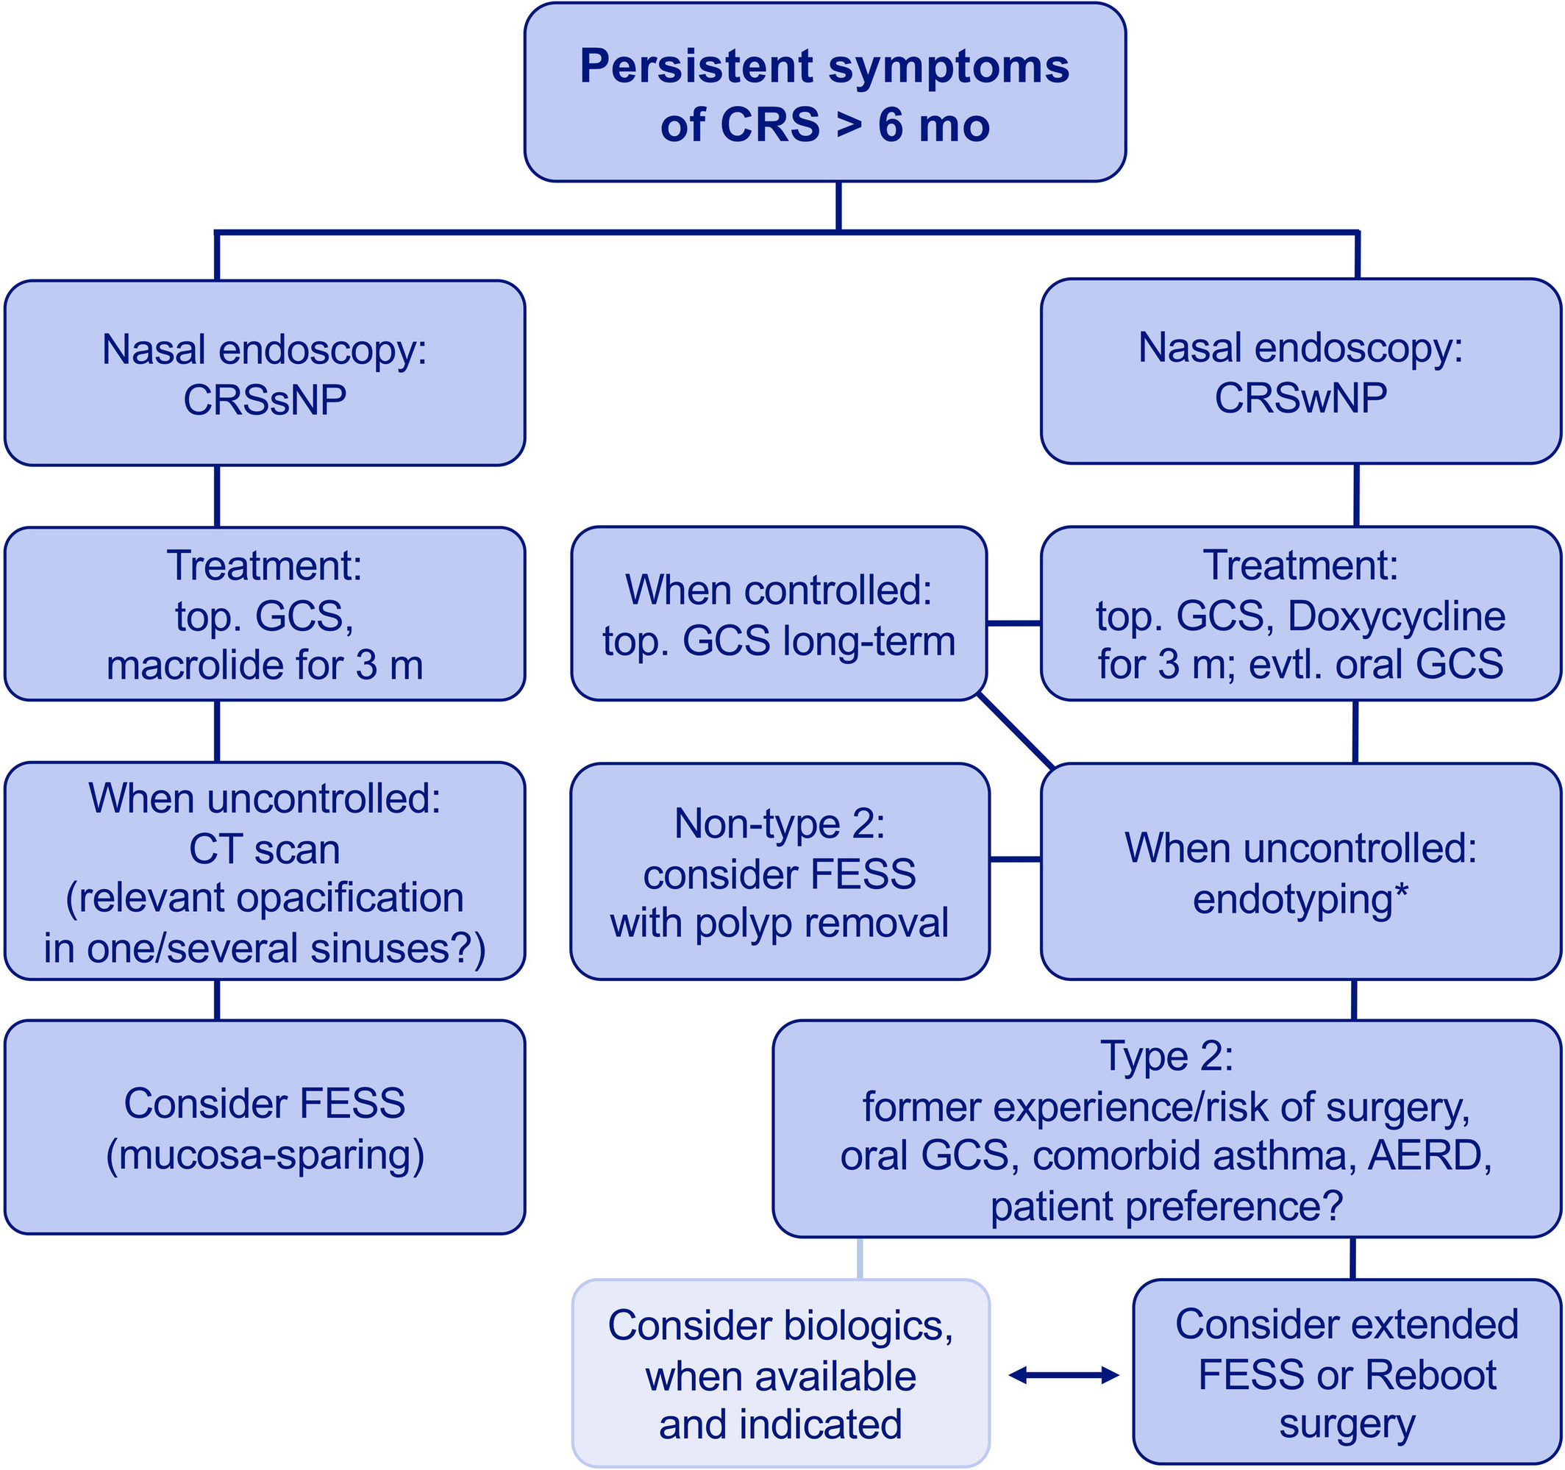
Medical algorithm: Diagnosis and treatment of chronic rhinosinusitis
Claus Bachert, Nan Zhang
Allergy, Volume: 75, Issue: 1, Pages: 240-242, First published: 16 April 2019, DOI: (10.1111/all.13823)
Notes:
Management algorithm for chronic rhinosinusitis (CRS, suggestion of the authors). *Type 2 markers: late‐onset asthma, increased blood eosinophils, elevated total IgE, polysensitization and others [Colour figure can be viewed at wileyonlinelibrary.com]
IF THIS IMAGE HAS BEEN PROVIDED BY OR IS OWNED BY A THIRD PARTY, AS INDICATED IN THE CAPTION LINE, THEN FURTHER PERMISSION MAY BE NEEDED BEFORE ANY FURTHER USE. PLEASE CONTACT WILEY'S PERMISSIONS DEPARTMENT ON PERMISSIONS@WILEY.COM OR USE THE RIGHTSLINK SERVICE BY CLICKING ON THE 'REQUEST PERMISSIONS' LINK ACCOMPANYING THIS ARTICLE. WILEY OR AUTHOR OWNED IMAGES MAY BE USED FOR NON-COMMERCIAL PURPOSES, SUBJECT TO PROPER CITATION OF THE ARTICLE, AUTHOR, AND PUBLISHER.

