Slide 1
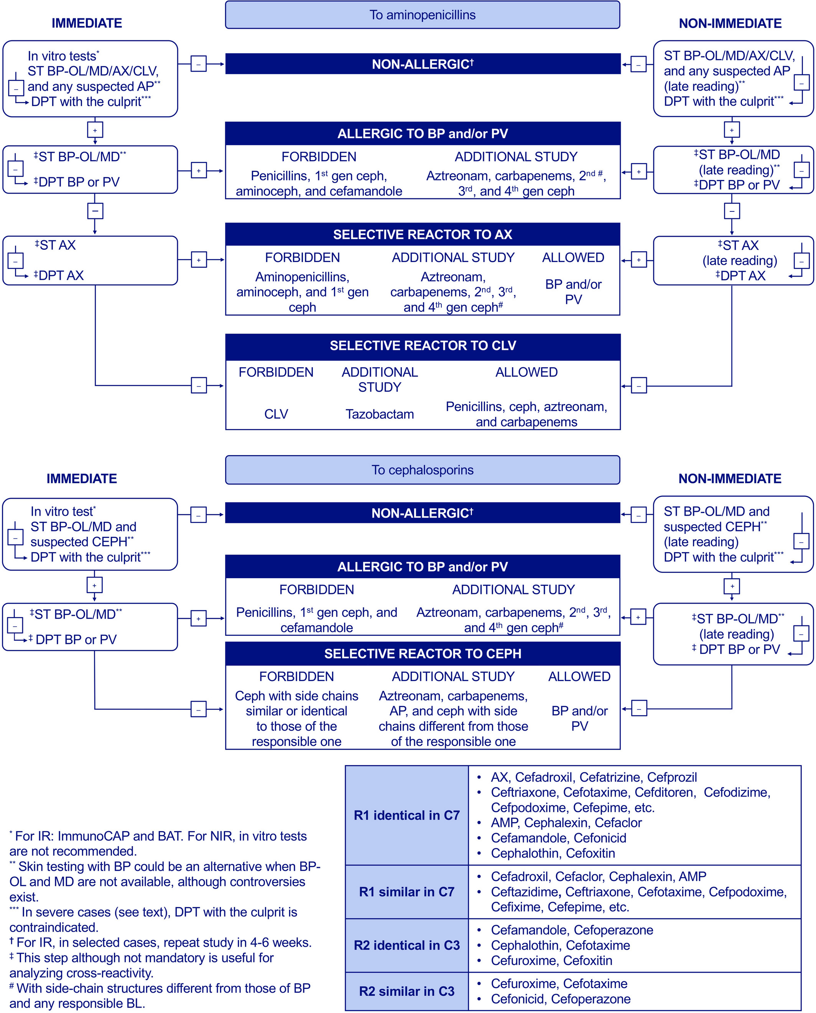
Algorithm for betalactam allergy diagnosis
Inmaculada Doña, Antonino Romano, María José Torres
Allergy, Volume: 74, Issue: 9, Pages: 1817-1819, First published: 29 April 2019, DOI: (10.1111/all.13844)
Notes:
Algorithm for betalactam allergy diagnosis
IF THIS IMAGE HAS BEEN PROVIDED BY OR IS OWNED BY A THIRD PARTY, AS INDICATED IN THE CAPTION LINE, THEN FURTHER PERMISSION MAY BE NEEDED BEFORE ANY FURTHER USE. PLEASE CONTACT WILEY'S PERMISSIONS DEPARTMENT ON PERMISSIONS@WILEY.COM OR USE THE RIGHTSLINK SERVICE BY CLICKING ON THE 'REQUEST PERMISSIONS' LINK ACCOMPANYING THIS ARTICLE. WILEY OR AUTHOR OWNED IMAGES MAY BE USED FOR NON-COMMERCIAL PURPOSES, SUBJECT TO PROPER CITATION OF THE ARTICLE, AUTHOR, AND PUBLISHER.

