Slide 1
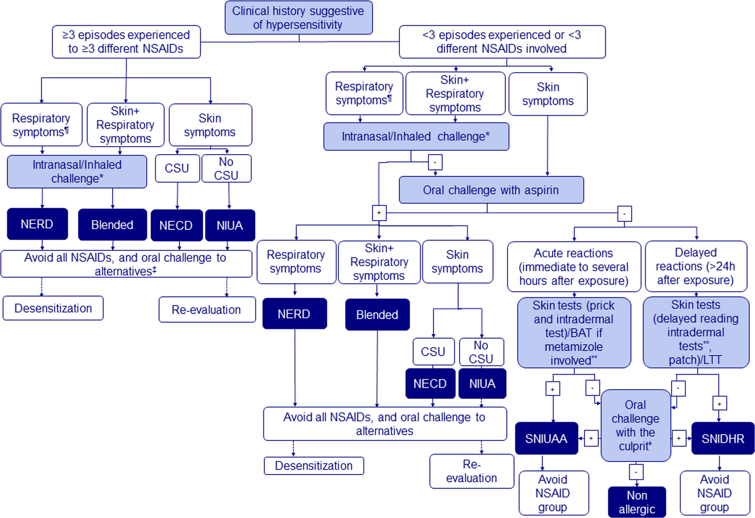
Medical algorithm: Diagnosis and treatment of nonsteroidal antiinflammatory drugs hypersensitivity
Inmaculada Doña, Natalia Pérez-Sánchez, Gádor Bogas, Esther Moreno, María Salas, María José Torres
Allergy, Volume: 75, Issue: 4, Pages: 1003-1005, First published: 19 November 2019, DOI: (10.1111/all.14119)
Notes:
Algorithm for diagnosing and managing patients with suspected hypersensitivity reactions to NSAIDs. ¶NERD can be diagnosed with high probability if >1 reaction occurred, reactions to ≥2 different NSAIDs have been reported, the latest reaction occurred within the last 5 y, and the underlying chronic respiratory disorders exist. *When the history of respiratory symptoms is not convincing of NERD, intranasal or inhaled challenge is recommended. **ST with metamizole: 40‐400 mg/mL for skin prick test, 0.4‐4 mg/mL for intradermal test (use diluted 10‐fold or lower if severe reactions due to the risk for developing systemic reactions). ᶲContraindicated if severe reactions
IF THIS IMAGE HAS BEEN PROVIDED BY OR IS OWNED BY A THIRD PARTY, AS INDICATED IN THE CAPTION LINE, THEN FURTHER PERMISSION MAY BE NEEDED BEFORE ANY FURTHER USE. PLEASE CONTACT WILEY'S PERMISSIONS DEPARTMENT ON PERMISSIONS@WILEY.COM OR USE THE RIGHTSLINK SERVICE BY CLICKING ON THE 'REQUEST PERMISSIONS' LINK ACCOMPANYING THIS ARTICLE. WILEY OR AUTHOR OWNED IMAGES MAY BE USED FOR NON-COMMERCIAL PURPOSES, SUBJECT TO PROPER CITATION OF THE ARTICLE, AUTHOR, AND PUBLISHER.

