Slide 1
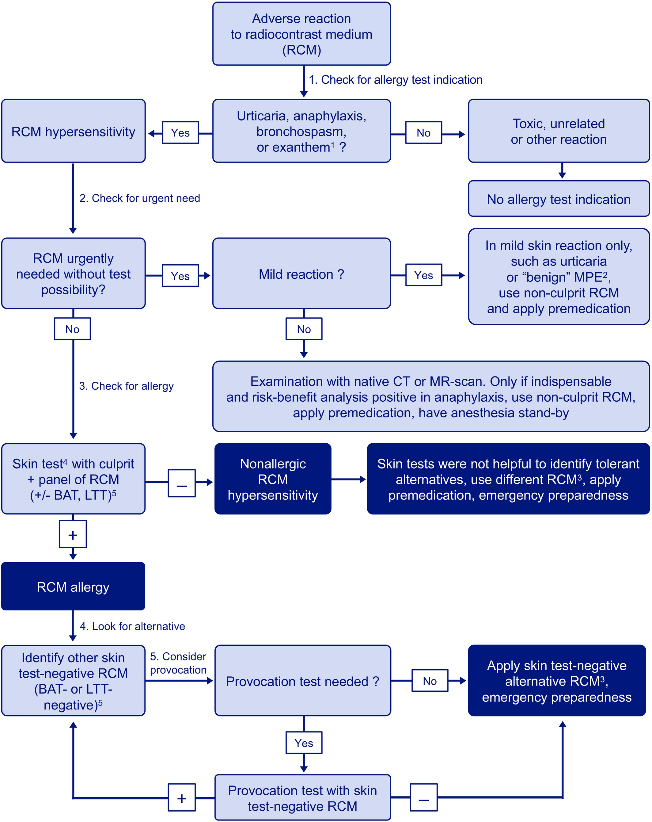
Medical algorithm: Diagnosis and treatment of radiocontrast media hypersensitivity
Knut Brockow
Allergy, Volume: 75, Issue: 5, Pages: 1278-1280, First published: 11 December 2019, DOI: (10.1111/all.14147)
Notes:
Management of patients with previous radiocontrast medium reaction. (1) Patients with history of anaphylaxis, bronchospasm, urticaria and/or angioedema and exanthems to RCM should undergo allergological work‐up. Those with severe NIHRs, as bullous exanthems or with systemic symptoms, should avoid future RCM application, whereas skin tests can be done. (2) In patients with mild IHR (urticaria ± angioedema) or NIHR (maculopapular exanthem) and urgent need for RCM‐based imaging, a nonculprit RCM may be given after premedication. In patients with anaphylaxis, RCM should be avoided and native CT or MRI scan performed. If RCM is considered indispensable and a risk‐benefit analysis positive, best administer the RCM after premedication and in emergency preparedness including anesthesia stand‐by. (3) For best sensitivity, skin tests are done 2‐6 months after the reaction. Skin prick test and, if negative, intradermal test are performed, in NIHR additionally patch tests. Test concentrations and reading times differ between IHR and NIHR (Table ). The culprits of previous reactions are skin tested. If positive, or if the culprit is unknown, a panel of available RCM is added. Basophil activation test (BAT) and lymphocyte transformation tests (LTT) may optionally be used. If no RCM allergy can be demonstrated by positive skin tests to the tested RCM (nonallergic RCM hypersensitivity), further skin tests are not helpful, thus use a nonculprit RCM and apply premedication under emergency preparedness. (4) If skin tests are positive to the culprit, RCM allergy is diagnosed and alternative skin test‐negative (± BAT‐ or LTT‐negative) alternative RCMs are looked for. (5) Provocation tests confirm tolerability to a skin test‐negative RCM, for example after very severe reaction, but are often dispensable. Otherwise, a skin test‐negative alternative RCM is administered without premedication under emergency preparedness
IF THIS IMAGE HAS BEEN PROVIDED BY OR IS OWNED BY A THIRD PARTY, AS INDICATED IN THE CAPTION LINE, THEN FURTHER PERMISSION MAY BE NEEDED BEFORE ANY FURTHER USE. PLEASE CONTACT WILEY'S PERMISSIONS DEPARTMENT ON PERMISSIONS@WILEY.COM OR USE THE RIGHTSLINK SERVICE BY CLICKING ON THE 'REQUEST PERMISSIONS' LINK ACCOMPANYING THIS ARTICLE. WILEY OR AUTHOR OWNED IMAGES MAY BE USED FOR NON-COMMERCIAL PURPOSES, SUBJECT TO PROPER CITATION OF THE ARTICLE, AUTHOR, AND PUBLISHER.

