Slide 1
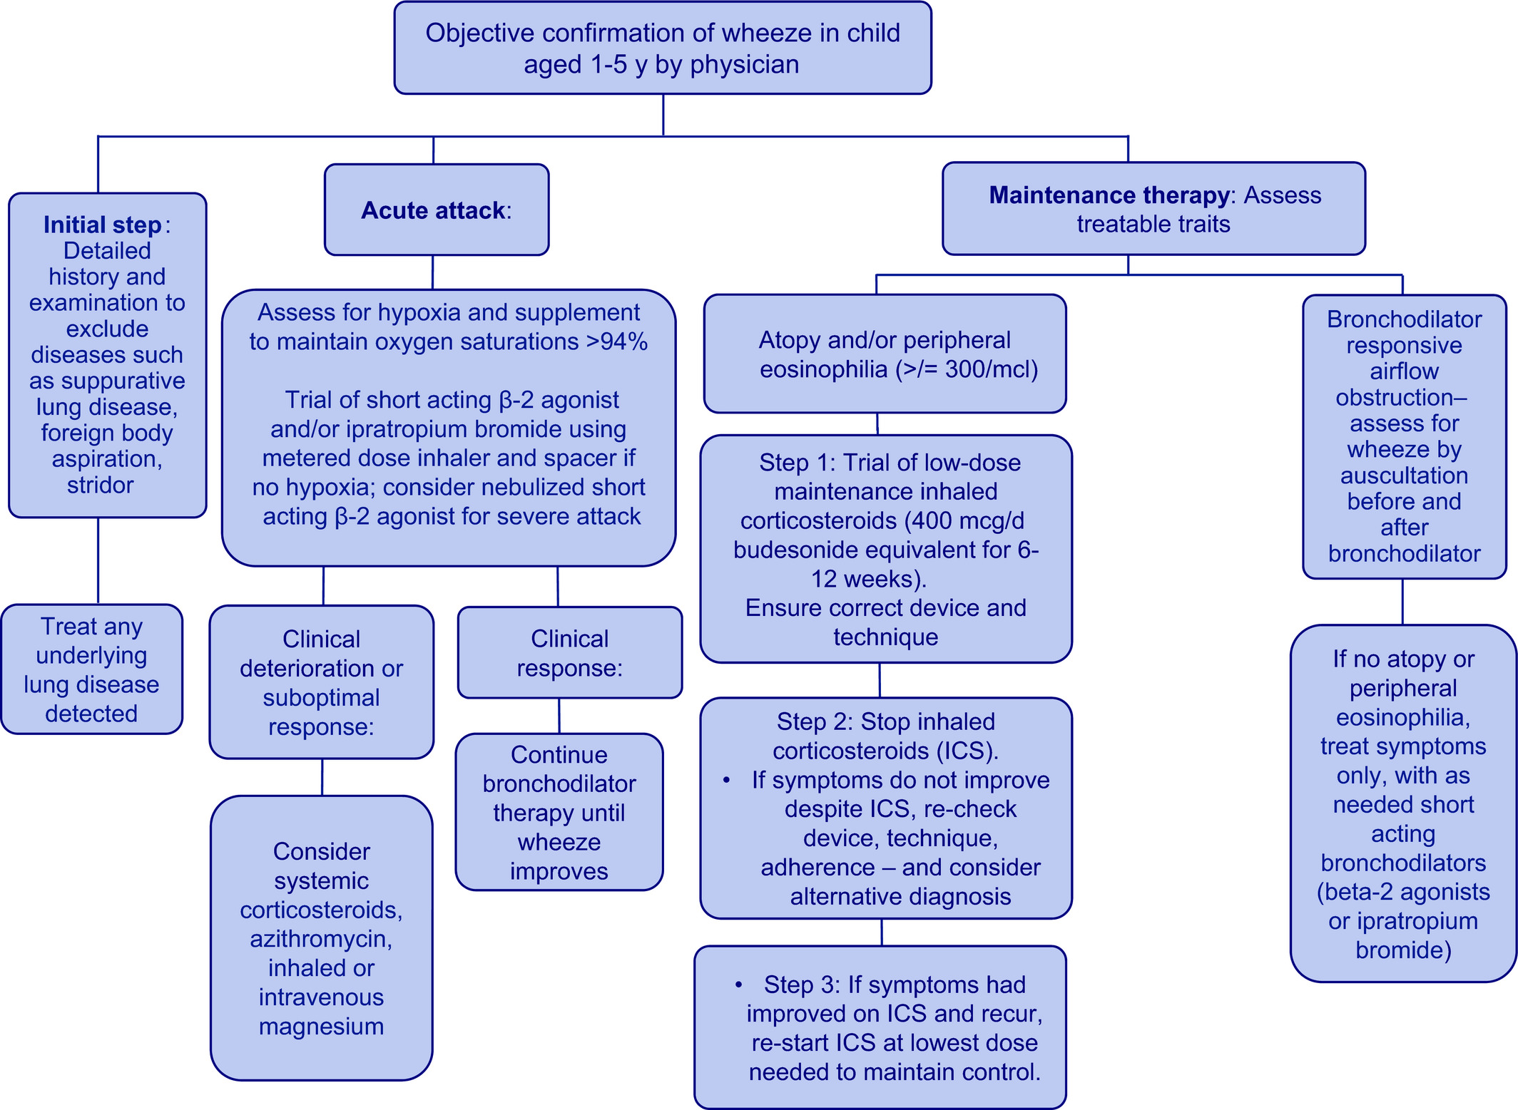
Medical algorithm: Diagnosis and treatment of preschool asthma
Andrew Bush, Sejal Saglani
Allergy, Volume: 75, Issue: 10, Pages: 2711-2712, First published: 03 January 2020, DOI: (10.1111/all.14172)
Notes:
Management algorithm for the preschool child presenting with wheezing/asthma
IF THIS IMAGE HAS BEEN PROVIDED BY OR IS OWNED BY A THIRD PARTY, AS INDICATED IN THE CAPTION LINE, THEN FURTHER PERMISSION MAY BE NEEDED BEFORE ANY FURTHER USE. PLEASE CONTACT WILEY'S PERMISSIONS DEPARTMENT ON PERMISSIONS@WILEY.COM OR USE THE RIGHTSLINK SERVICE BY CLICKING ON THE 'REQUEST PERMISSIONS' LINK ACCOMPANYING THIS ARTICLE. WILEY OR AUTHOR OWNED IMAGES MAY BE USED FOR NON-COMMERCIAL PURPOSES, SUBJECT TO PROPER CITATION OF THE ARTICLE, AUTHOR, AND PUBLISHER.

