Slide 1
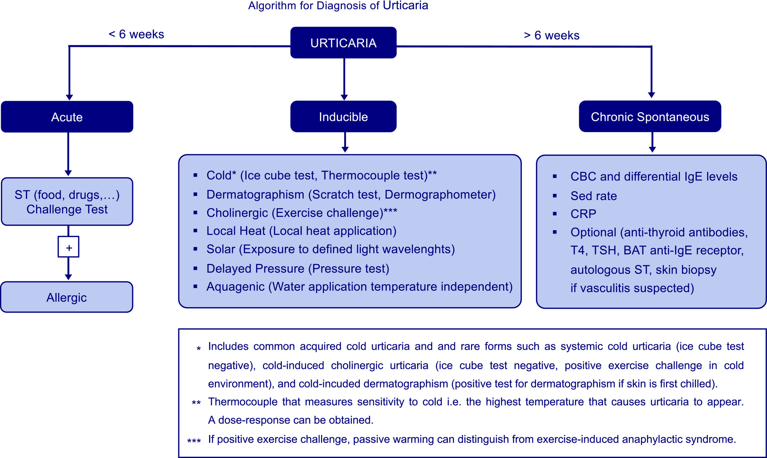
Diagnosis and treatment of chronic spontaneous urticaria
Allen P. Kaplan
Allergy, Volume: 75, Issue: 7, Pages: 1830-1832, First published: 19 February 2020, DOI: (10.1111/all.14192)
Notes:
Algorithm for diagnosis of chronic spontaneous urticaria
IF THIS IMAGE HAS BEEN PROVIDED BY OR IS OWNED BY A THIRD PARTY, AS INDICATED IN THE CAPTION LINE, THEN FURTHER PERMISSION MAY BE NEEDED BEFORE ANY FURTHER USE. PLEASE CONTACT WILEY'S PERMISSIONS DEPARTMENT ON PERMISSIONS@WILEY.COM OR USE THE RIGHTSLINK SERVICE BY CLICKING ON THE 'REQUEST PERMISSIONS' LINK ACCOMPANYING THIS ARTICLE. WILEY OR AUTHOR OWNED IMAGES MAY BE USED FOR NON-COMMERCIAL PURPOSES, SUBJECT TO PROPER CITATION OF THE ARTICLE, AUTHOR, AND PUBLISHER.

