Slide 1
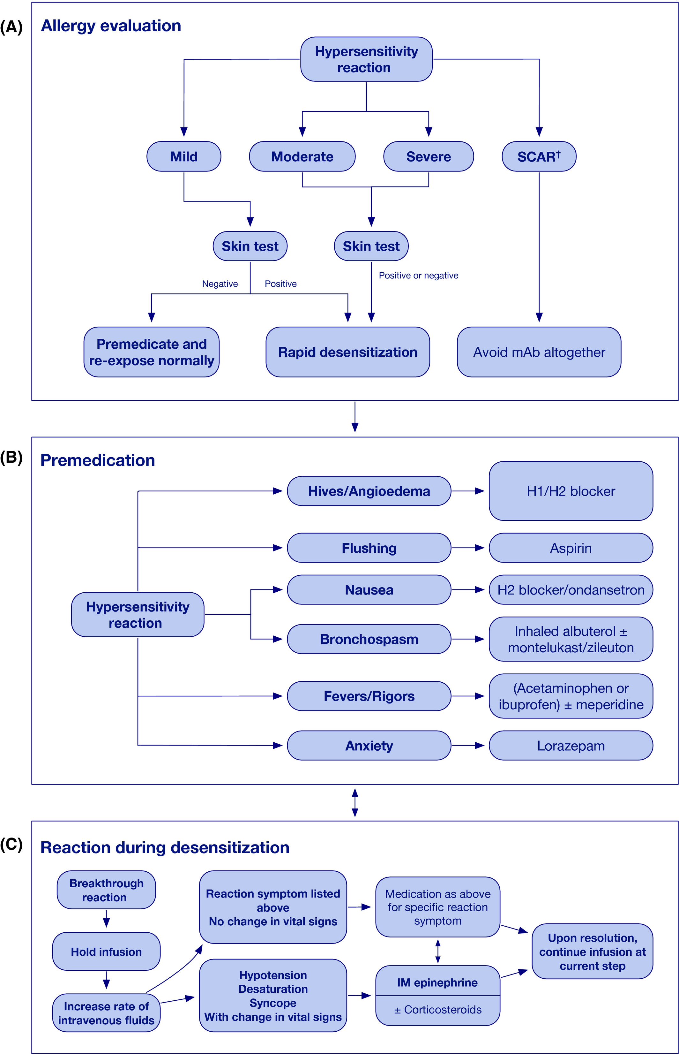
Medical algorithm: Diagnosis and treatment of drug hypersensitivity reactions to biologicals
Barbara Carolyn Yang, Mariana Castells
Allergy, Volume: 75, Issue: 12, Pages: 3293-3296, First published: 04 June 2020, DOI: (10.1111/all.14432)
Notes:
Schematic of management of a patient with hypersensitivity reaction to monoclonal antibodies. A, The severity of reaction along with skin testing results is used to guide if patient is a candidate for desensitization. B, All patients are premedicated with cetirizine and famotidine. If there is nausea, administer ondansetron. If fevers/rigors, utilize acetaminophen and meperidine. If the patient experiences flushing, give aspirin. If anxiety, use lorazepam. If bronchospasm, administer beta‐agonist inhaled therapy and anti‐leukotriene therapy. If the initial reaction was severe (with hypotension, etc), then the patient can be premedicated with steroids, but this is not a baseline required premedication as it generally does not reduce morbidity. Beta blockers are completely withheld 24 hours prior to desensitization so as to not mask the symptoms of anaphylaxis and to allow the beta‐agonist activity of epinephrine if it becomes necessary to administer. C. Breakthrough reactions during desensitization are managed by the use of the same premedications listed previously, but with the point of treating the acute symptoms that are being experienced by the patient at the time. If there is a change in vital signs, such as desaturation or hypotension, we immediately increase the rate of intravenous fluids to >500 cc/hr and we treat for anaphylaxis with intramuscular epinephrine and then possibly supplement later with steroid therapy
IF THIS IMAGE HAS BEEN PROVIDED BY OR IS OWNED BY A THIRD PARTY, AS INDICATED IN THE CAPTION LINE, THEN FURTHER PERMISSION MAY BE NEEDED BEFORE ANY FURTHER USE. PLEASE CONTACT WILEY'S PERMISSIONS DEPARTMENT ON PERMISSIONS@WILEY.COM OR USE THE RIGHTSLINK SERVICE BY CLICKING ON THE 'REQUEST PERMISSIONS' LINK ACCOMPANYING THIS ARTICLE. WILEY OR AUTHOR OWNED IMAGES MAY BE USED FOR NON-COMMERCIAL PURPOSES, SUBJECT TO PROPER CITATION OF THE ARTICLE, AUTHOR, AND PUBLISHER.

