Slide 1
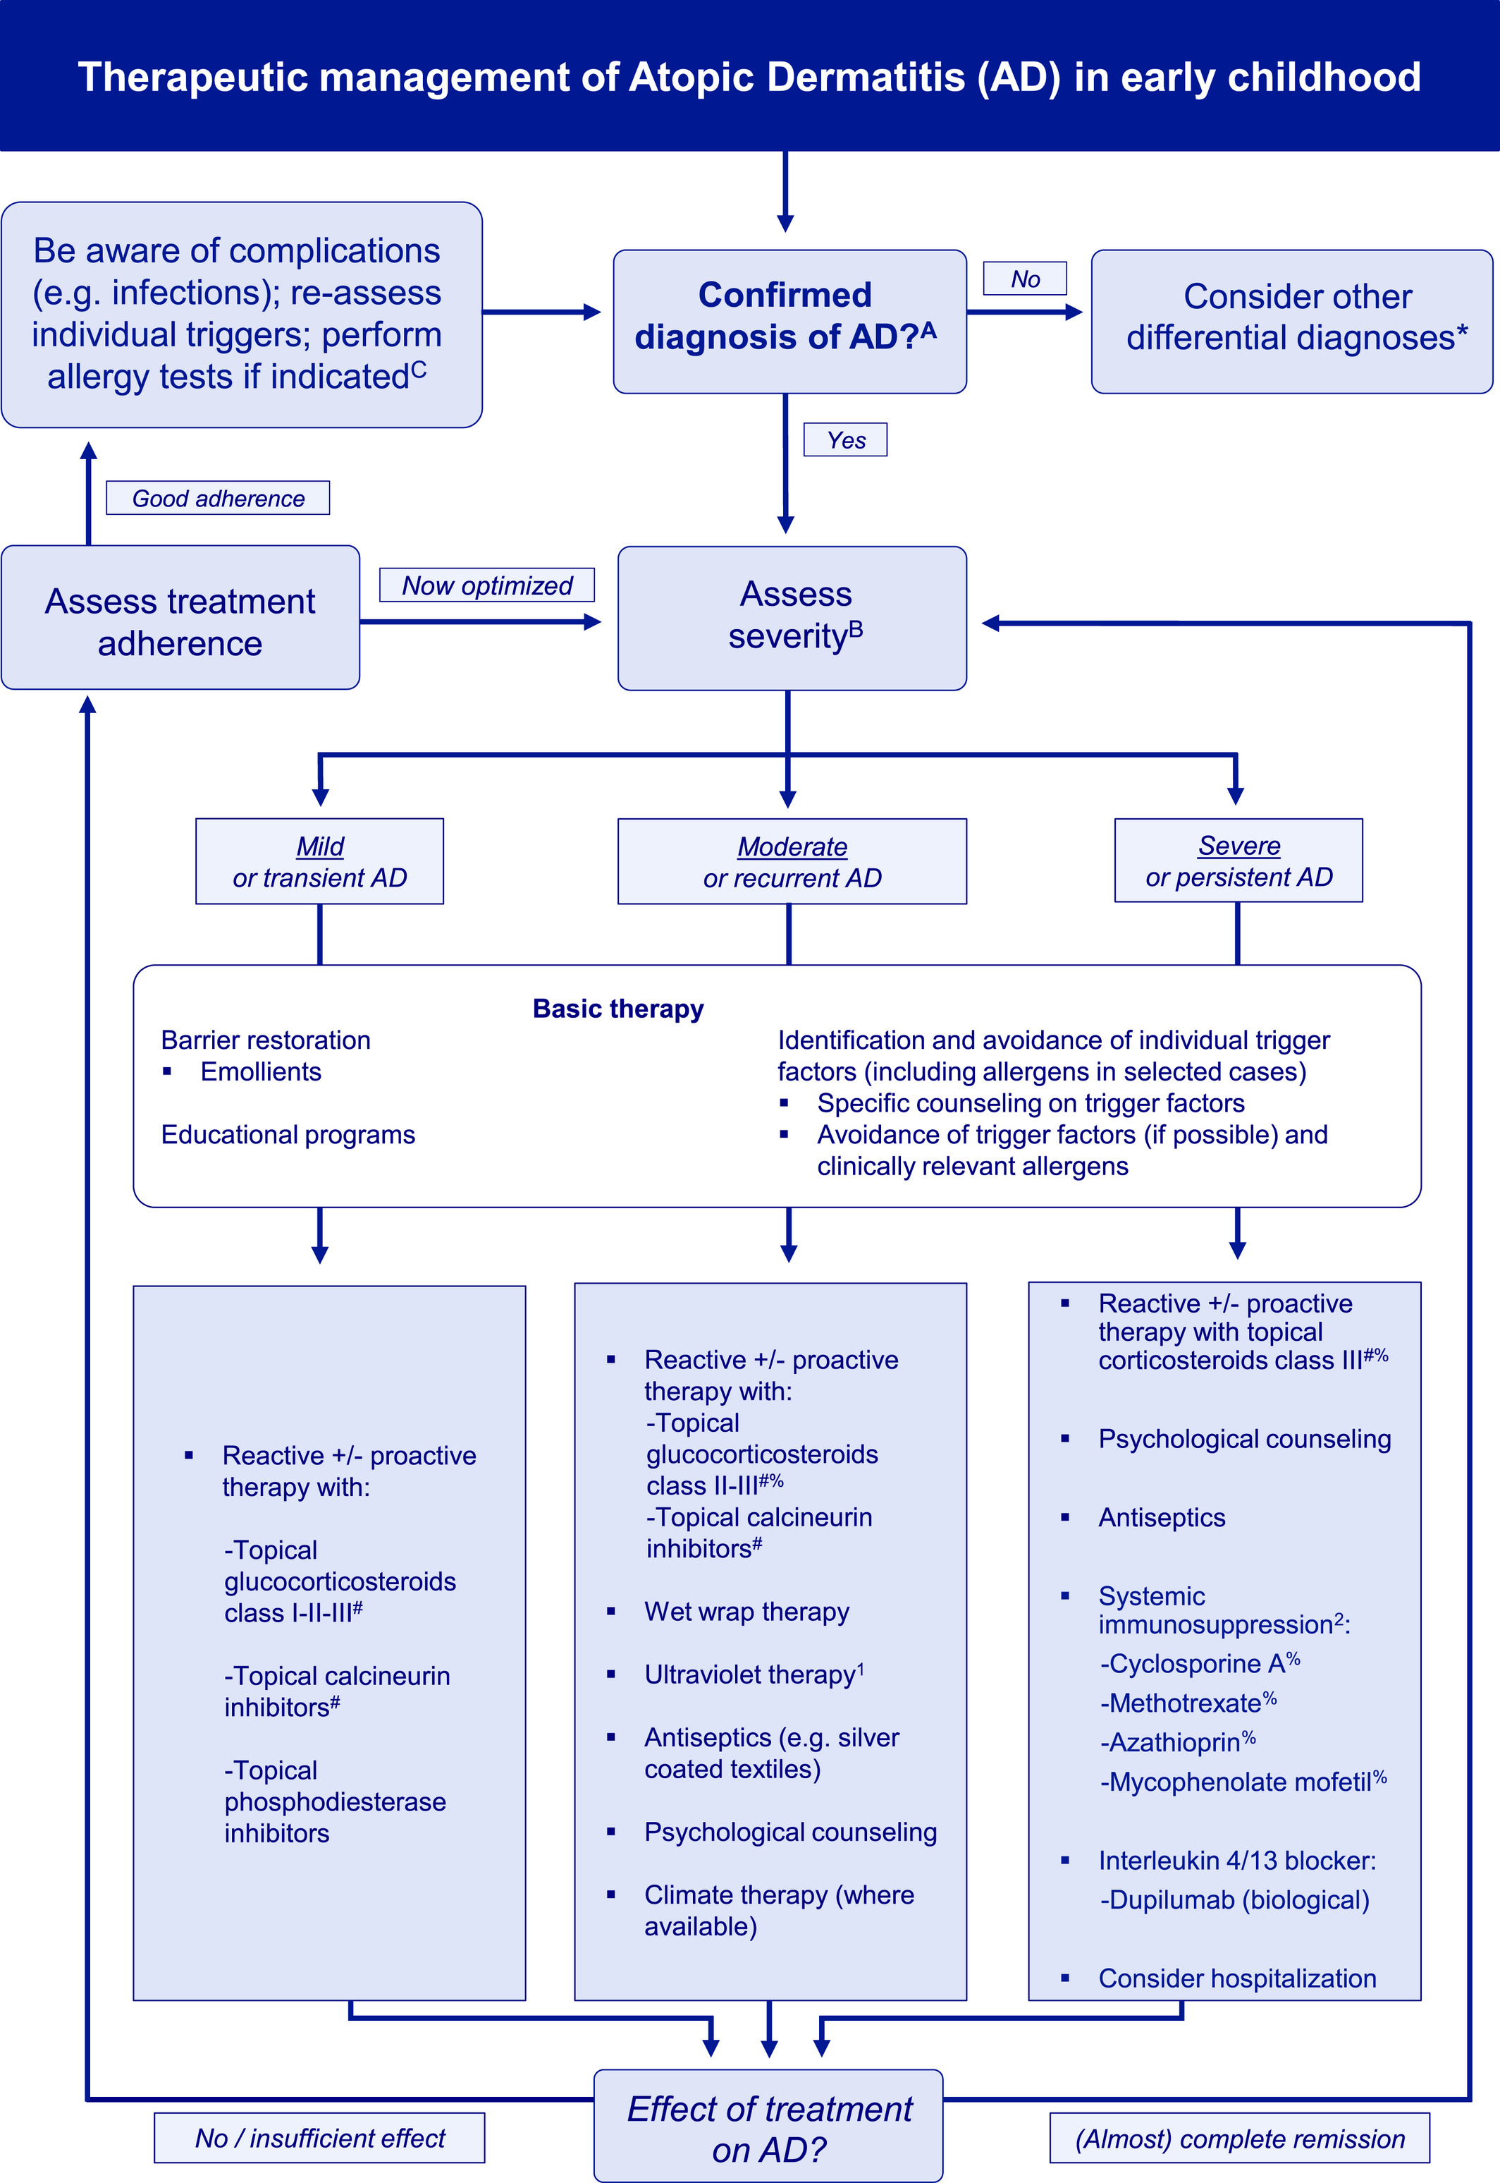
Medical algorithm: Treatment of atopic dermatitis in early childhood (part II)
Sherief R. Janmohamed, Johannes Ring, Lawrence F. Eichenfield, Jan Gutermuth
Allergy, Volume: 76, Issue: 1, Pages: 407-410, First published: 09 August 2020, DOI: (10.1111/all.14512)
Notes:
Medical algorithm for the therapeutic management of atopic dermatitis (AD) in early childhood, based on severity. Adapted from: Wollenberg A et al, J Eur Acad Dermatol Venereol, 2018.3 AFor criteria, see part I of this medical algorithm. BDisease severity scales can be used but might not be practical. Severity (global assessment) can alternatively be assessed by body surface area involvement, lesional features and locations, and disease impact on quality of life. CPlease refer to part I of this medical algorithm. 1Not commonly used in early childhood (feasibility). Preference for narrowband ultraviolet B (311 nm) or ultraviolet A1. 2Cyclosporine is licensed from age 16 and dupilumab from age 12 in Europe (approval for children aged 6 years and older is expected soon). All other systemic options are off label. #Choice depending on local cofactors. For moderate‐severe AD, it is recommended to start with a corticosteroid. Choice of corticosteroid class (European classification shown) depending on age and local cofactors. %Off‐label treatment option. *Special attention if age <3 mo or recurring infections: in early‐onset severe AD, certain primary immunodeficiency syndromes such as Omenn syndrome, selective IgA‐deficiency, Hyper‐IgE‐syndromes and Wiskott Aldrich syndrome, genetic disorders with an impaired barrier function, such as Comel‐Netherton syndrome and peeling skin syndrome, and some inherited metabolic diseases such as biotin deficiency or phenylketonuria should be considered as differential diagnoses
IF THIS IMAGE HAS BEEN PROVIDED BY OR IS OWNED BY A THIRD PARTY, AS INDICATED IN THE CAPTION LINE, THEN FURTHER PERMISSION MAY BE NEEDED BEFORE ANY FURTHER USE. PLEASE CONTACT WILEY'S PERMISSIONS DEPARTMENT ON PERMISSIONS@WILEY.COM OR USE THE RIGHTSLINK SERVICE BY CLICKING ON THE 'REQUEST PERMISSIONS' LINK ACCOMPANYING THIS ARTICLE. WILEY OR AUTHOR OWNED IMAGES MAY BE USED FOR NON-COMMERCIAL PURPOSES, SUBJECT TO PROPER CITATION OF THE ARTICLE, AUTHOR, AND PUBLISHER.

