Slide 1
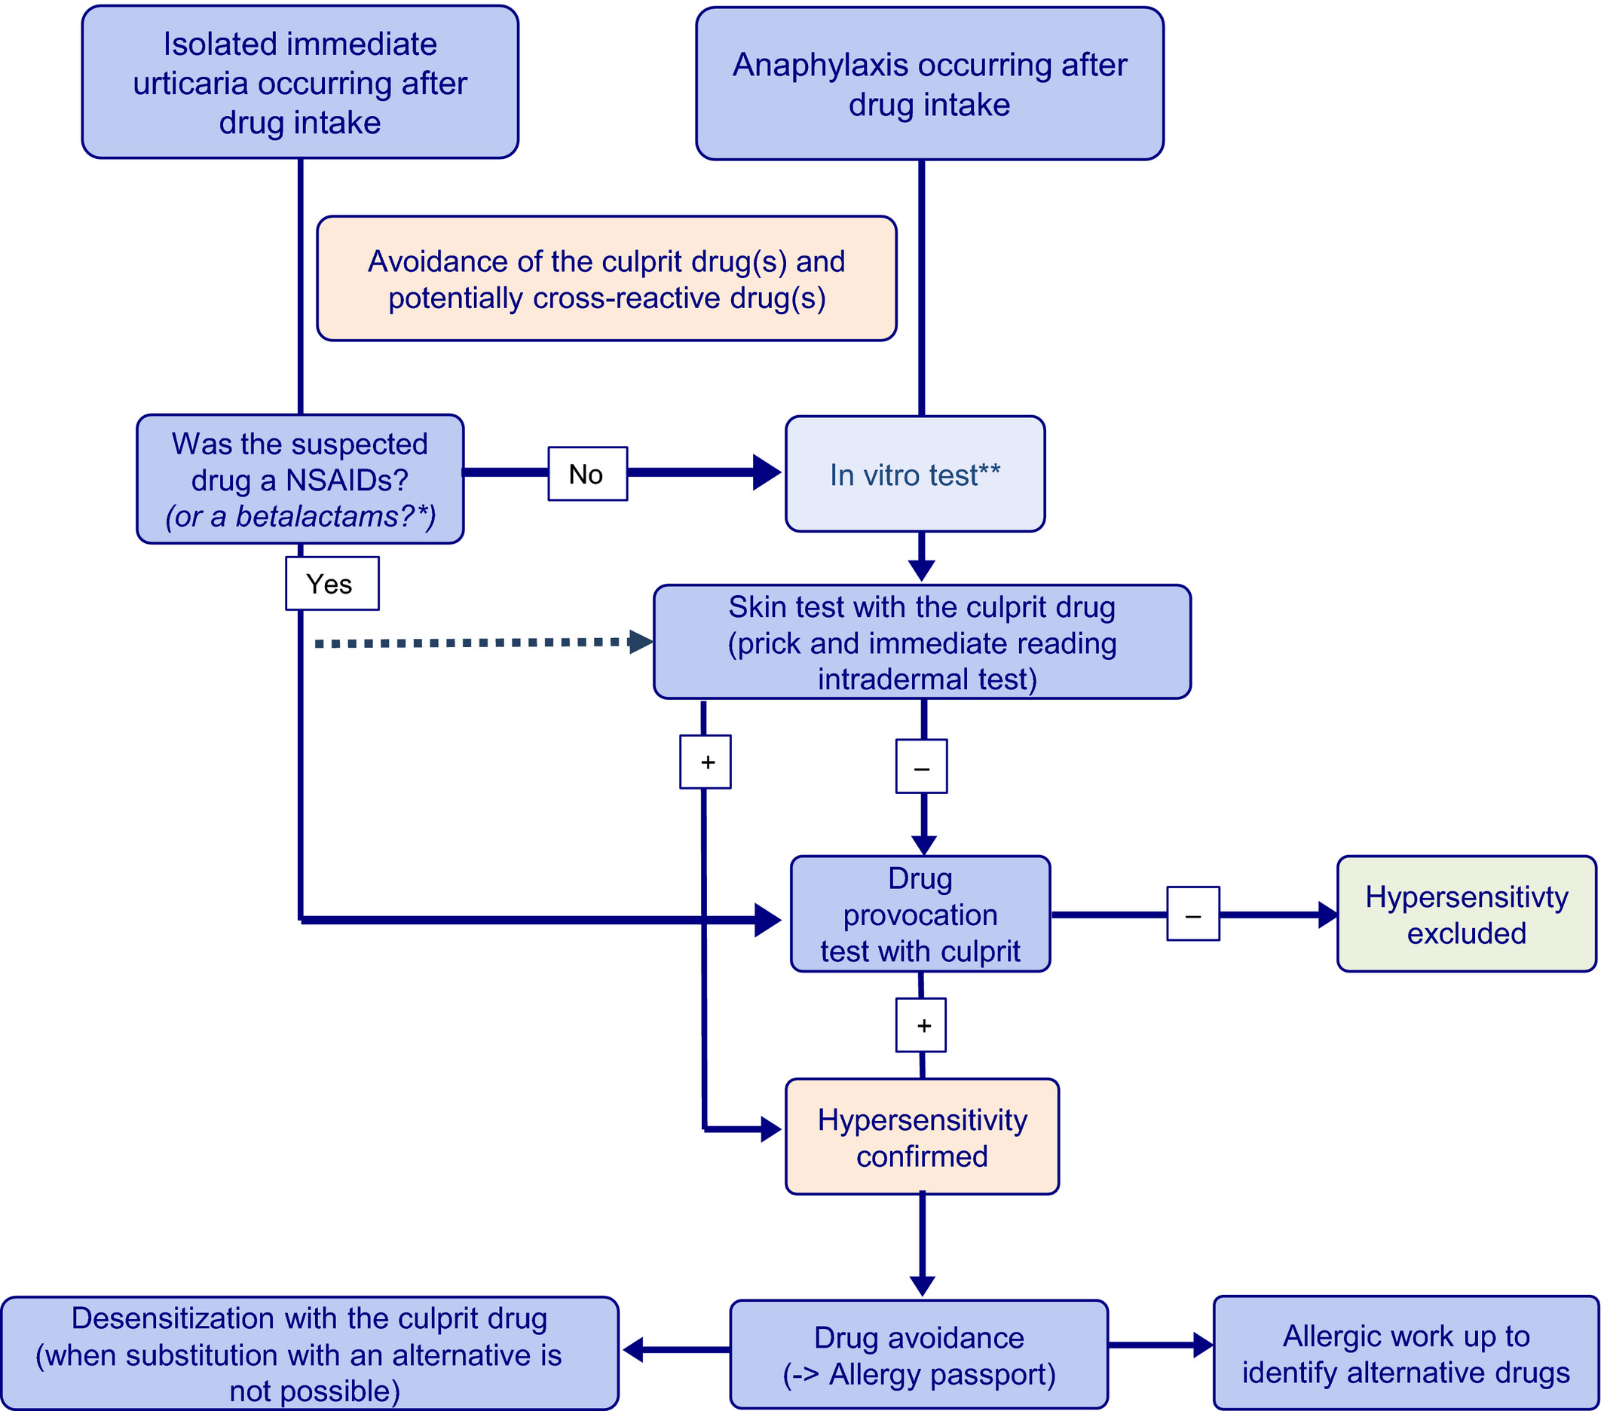
Management of children with a suspicion of immediate drug hypersensitivity
Jean-Christoph Caubet
Allergy, Volume: 76, Issue: 3, Pages: 940-941, First published: 26 July 2020, DOI: (10.1111/all.14521)
Notes:
Management of children with a suspicion of immediate drug hypersensitivity. *For BL, some authors have suggested to skip skin test in case of benign immediate urticaria. However, based on the current evidence, such approach could not be recommended. **if tests are available
IF THIS IMAGE HAS BEEN PROVIDED BY OR IS OWNED BY A THIRD PARTY, AS INDICATED IN THE CAPTION LINE, THEN FURTHER PERMISSION MAY BE NEEDED BEFORE ANY FURTHER USE. PLEASE CONTACT WILEY'S PERMISSIONS DEPARTMENT ON PERMISSIONS@WILEY.COM OR USE THE RIGHTSLINK SERVICE BY CLICKING ON THE 'REQUEST PERMISSIONS' LINK ACCOMPANYING THIS ARTICLE. WILEY OR AUTHOR OWNED IMAGES MAY BE USED FOR NON-COMMERCIAL PURPOSES, SUBJECT TO PROPER CITATION OF THE ARTICLE, AUTHOR, AND PUBLISHER.

