Slide 1
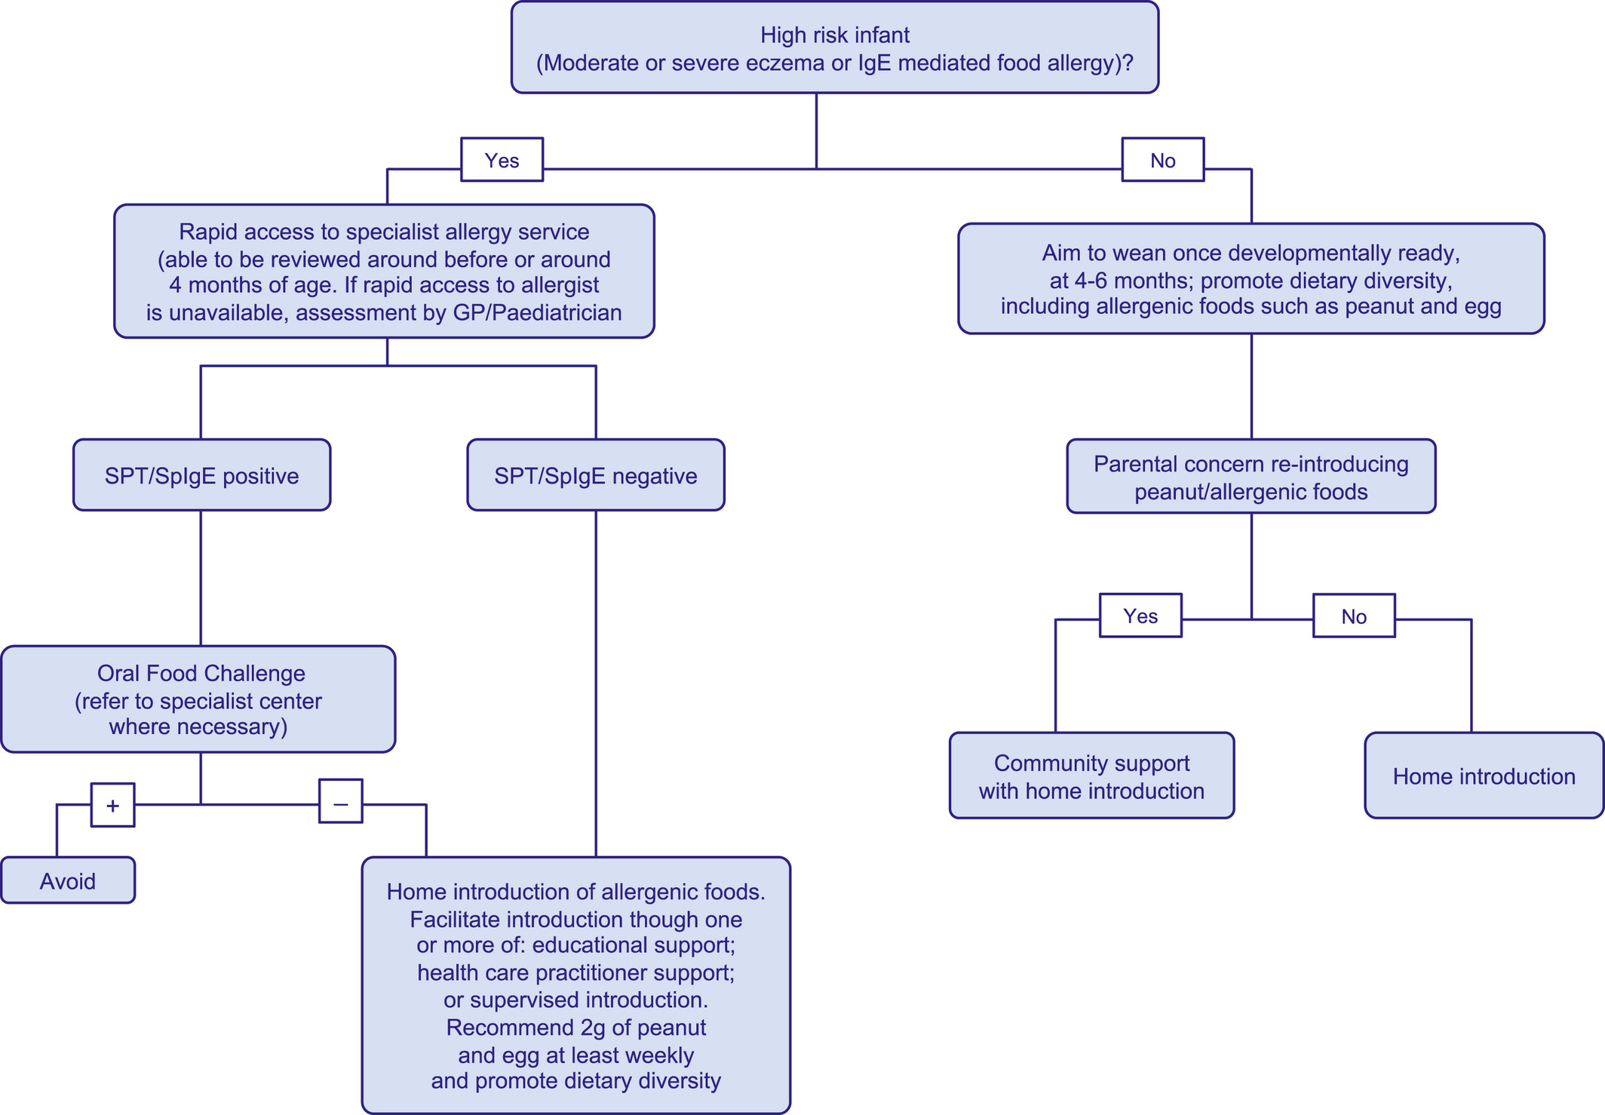
Medical algorithm: Early introduction of food allergens in high‐risk populations
Helen R. Fisher, Gideon Lack, Graham Roberts, Henry T. Bahnson, George Du Toit
Allergy, Volume: 76, Issue: 5, Pages: 1592-1594, First published: 21 December 2020, DOI: (10.1111/all.14717)
Notes:
Organogram depicting risk‐based approach to weaning for the prevention of food allergy
IF THIS IMAGE HAS BEEN PROVIDED BY OR IS OWNED BY A THIRD PARTY, AS INDICATED IN THE CAPTION LINE, THEN FURTHER PERMISSION MAY BE NEEDED BEFORE ANY FURTHER USE. PLEASE CONTACT WILEY'S PERMISSIONS DEPARTMENT ON PERMISSIONS@WILEY.COM OR USE THE RIGHTSLINK SERVICE BY CLICKING ON THE 'REQUEST PERMISSIONS' LINK ACCOMPANYING THIS ARTICLE. WILEY OR AUTHOR OWNED IMAGES MAY BE USED FOR NON-COMMERCIAL PURPOSES, SUBJECT TO PROPER CITATION OF THE ARTICLE, AUTHOR, AND PUBLISHER.

