Slide 1
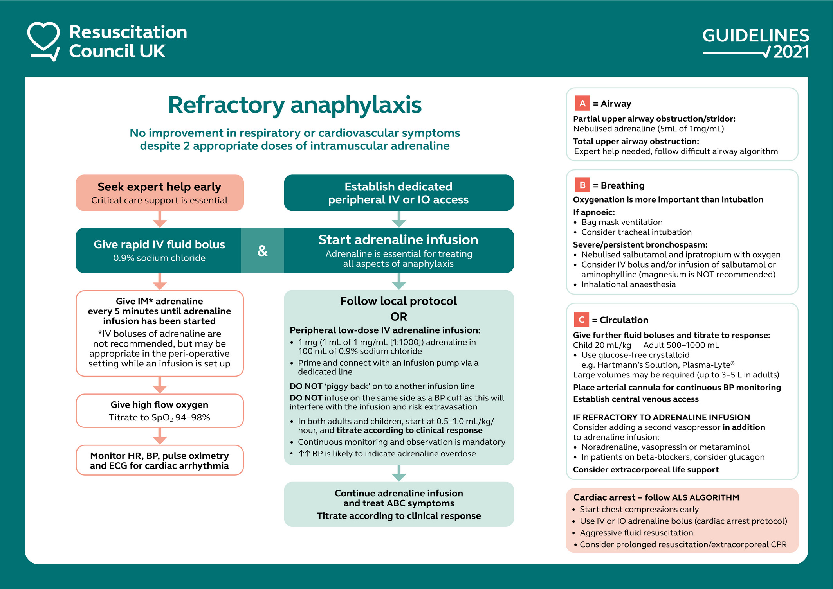
Refractory anaphylaxis: Treatment algorithm
Nicholas Sargant, Amy Dodd, Anna Hughes, Andrew F. Whyte, Jasmeet Soar, Paul J. Turner
Allergy, Volume: 76, Issue: 5, Pages: 1595-1597, First published: 16 February 2021, DOI: (10.1111/all.14780)
Notes:
Algorithm for refractory anaphylaxis (with permission from Resuscitation Council UK)
IF THIS IMAGE HAS BEEN PROVIDED BY OR IS OWNED BY A THIRD PARTY, AS INDICATED IN THE CAPTION LINE, THEN FURTHER PERMISSION MAY BE NEEDED BEFORE ANY FURTHER USE. PLEASE CONTACT WILEY'S PERMISSIONS DEPARTMENT ON PERMISSIONS@WILEY.COM OR USE THE RIGHTSLINK SERVICE BY CLICKING ON THE 'REQUEST PERMISSIONS' LINK ACCOMPANYING THIS ARTICLE. WILEY OR AUTHOR OWNED IMAGES MAY BE USED FOR NON-COMMERCIAL PURPOSES, SUBJECT TO PROPER CITATION OF THE ARTICLE, AUTHOR, AND PUBLISHER.

