Slide 1
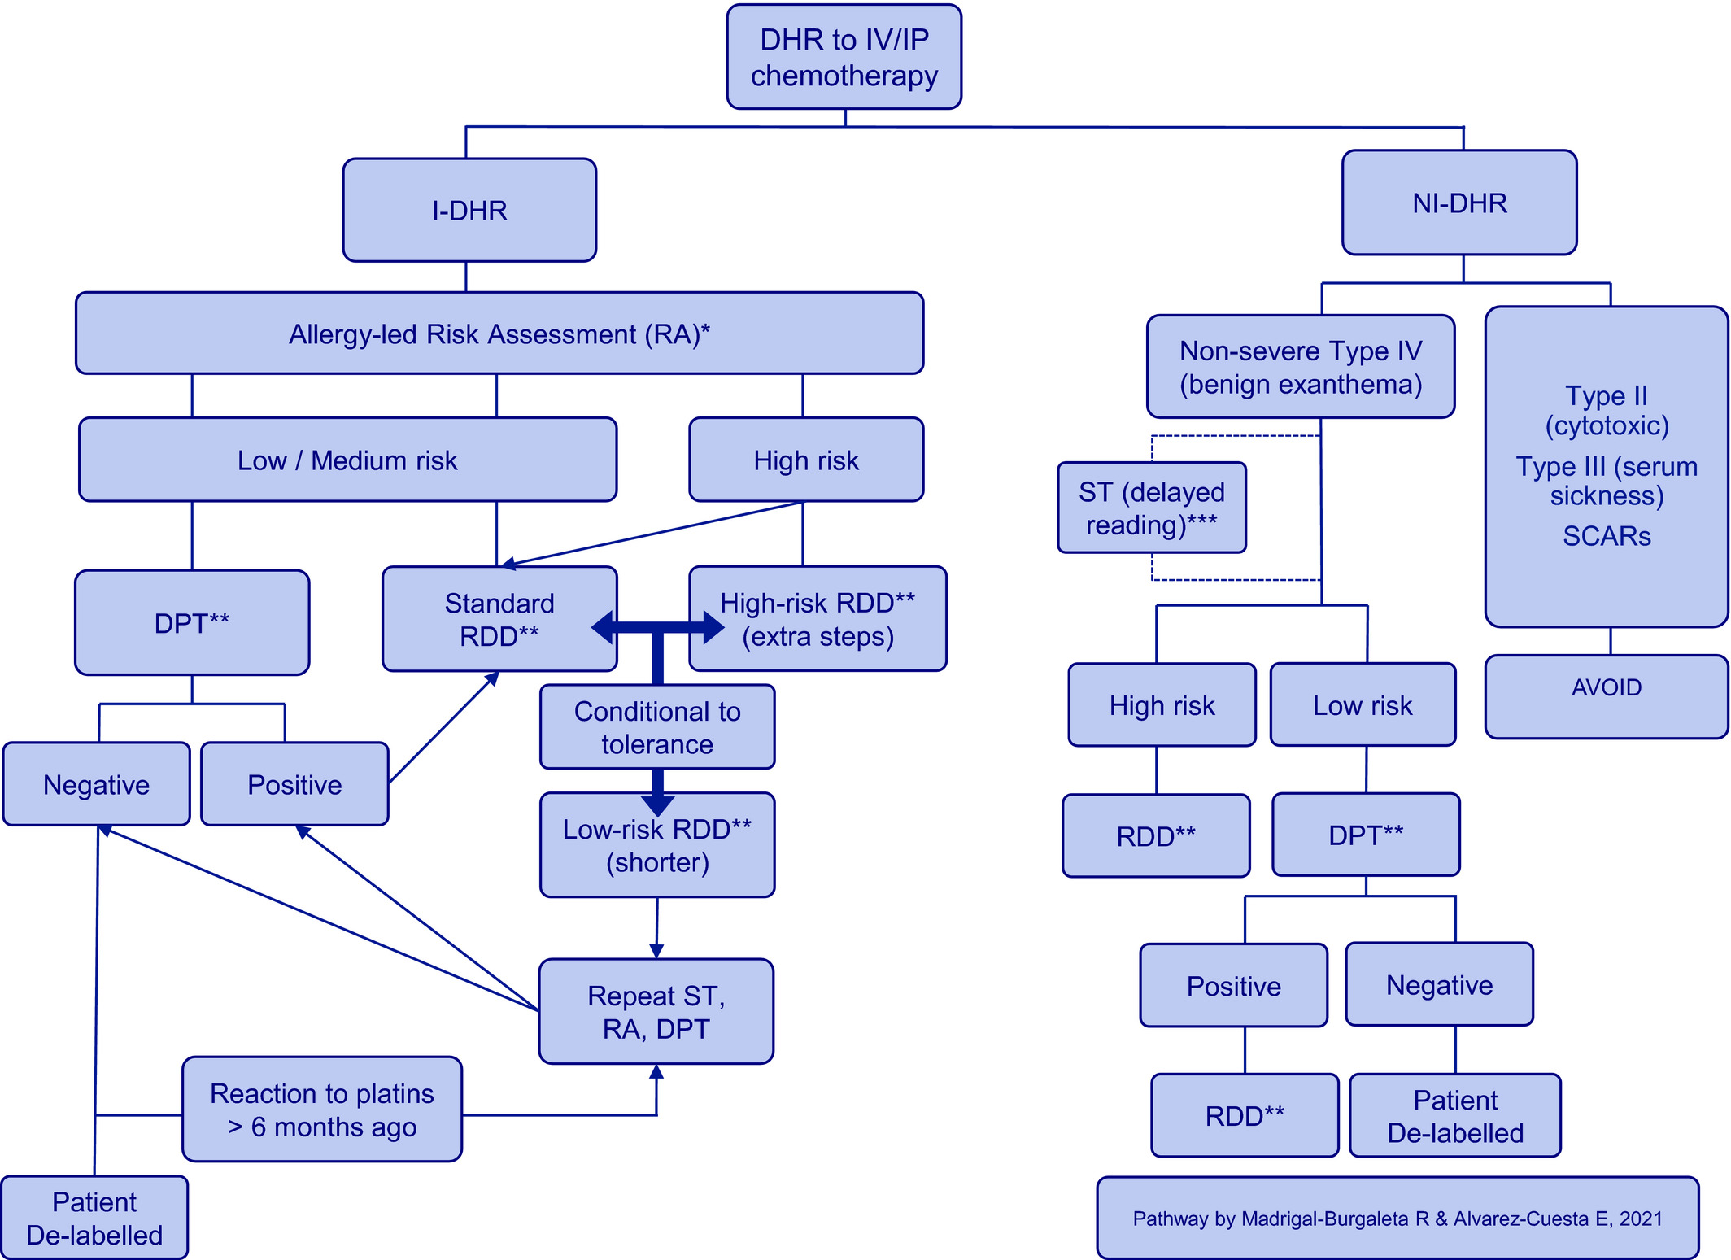
Medical algorithm: Diagnosis and treatment of hypersensitivity reactions to cancer chemotherapy
Ricardo Madrigal-Burgaleta, Paula Vazquez-Revuelta, Jaume Marti-Garrido, Ramon Lleonart-Bellfill, Fawzia Runa Ali, Emilio Alvarez-Cuesta
Allergy, Volume: 76, Issue: 8, Pages: 2636-2640, First published: 08 March 2021, DOI: (10.1111/all.14810)
Notes:
Abbreviations: DHR, drug hypersensitivity reactions; DPT, drug provocation testing; I‐DHR, immediate drug hypersensitivity reactions; IV/IP, intravenous or intraperitoneal; NI‐DHR, non‐immediate drug hypersensitivity reactions; RA, risk assessment; RDD, rapid drug desensitisation; SCARs, severe cutaneous adverse reactions such as Stevens‐Johnson syndrome, DRESS, AGEP, or toxic epidermal necrolysis; ST, skin testing. Defining risk categories for DPT: (i)We recommend a systematic discussion of each case in a multidisciplinary team meeting (involving all the staff that will manage the patient, as well as the patient). (ii) High risk (DPT not advisable): The presence of comorbidities where exposure might provoke situations beyond medical control (e.g. uncontrolled asthma or lung disease with FEV1 < 1 L, unavoidable use of b‐blockers, or mastocytosis), or previous life‐threatening reaction (history of intubation and cardiovascular collapse), lack of specific resources for DPT. (iii) Low and medium risk (DPT potentially advisable): These should be defined locally and for each drug, as several factors might influence this (e.g. some centres might have easy access to intensive care beds and consider riskier cases).Notes: *Risk assessment is dynamic and should at least include these factors in the multidisciplinary discussion on a case‐to‐case basis: (1) Endophenotype‐related factors: allergy workup risk markers, both in vivo and in vitro (ST, sIgE, tryptase, IL‐6, BAT). When ST is not available, the risk/benefit balance might then lean towards avoiding DPT, but carefully consider on a case‐to‐case basis. (2) DHR‐related: type of drug, severity of the reaction, previous life‐threatening reaction (such as a history of intubation or cardiovascular collapse), type of reaction, more than one drug involved in the reaction. (3) Exceptional situations like pregnancy, acute infections, critically ill patients, urgency to receive treatment, or clinical trials. (4) Institutional‐related factors, such as access to expert allergists with clinical expertise in drug allergy, access to a multidisciplinary team approach for each individual patient, trained staff, specific resources, appropriate facilities (special dedicated areas for these techniques, and access to intensive care), risk‐management strategies and worst‐case scenario recovery plans. (5) Patient‐related, such as comorbidities where exposure might provoke situations beyond medical control. (6) Social factors (travel distance to centre, level of anxiety, inclination toward DPT vs RDD). **These are high‐risk & high‐complexity procedures: They need to be personalised by expert allergists and be performed in dedicated allergy‐led spaces with specific resources. We recommend compliance with international guidance on DPT and RDD. ***There is virtually no experience with delayed reading ST, patch testing, or in vitro testing for non‐immediate reactions to chemotherapy.
IF THIS IMAGE HAS BEEN PROVIDED BY OR IS OWNED BY A THIRD PARTY, AS INDICATED IN THE CAPTION LINE, THEN FURTHER PERMISSION MAY BE NEEDED BEFORE ANY FURTHER USE. PLEASE CONTACT WILEY'S PERMISSIONS DEPARTMENT ON PERMISSIONS@WILEY.COM OR USE THE RIGHTSLINK SERVICE BY CLICKING ON THE 'REQUEST PERMISSIONS' LINK ACCOMPANYING THIS ARTICLE. WILEY OR AUTHOR OWNED IMAGES MAY BE USED FOR NON-COMMERCIAL PURPOSES, SUBJECT TO PROPER CITATION OF THE ARTICLE, AUTHOR, AND PUBLISHER.

