Slide 1
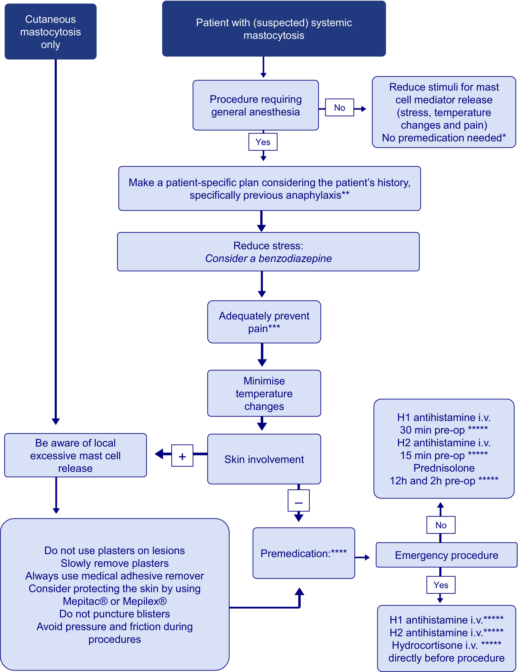
Medical algorithm: Peri‐operative management of mastocytosis patients
Inger Femke Astra Bocca-Tjeertes, Annick A. J. M. van de Ven, Gerard H. Koppelman, Aline B. Sprikkelman, Hanneke J. N. G. Oude Elberink
Allergy, Volume: 76, Issue: 10, Pages: 3233-3235, First published: 05 May 2021, DOI: (10.1111/all.14891)
Notes:
Algorithm for peri‐operative management of mastocytosis patients. Patients with a suspicion for underlying mastocytosis may undergo diagnostic testing needed for diagnosing mastocytosis (eg, bone marrow biopsy), requiring general anesthesia. This especially applies to pediatric patients. In this case, systemic mastocytosis is suspected, but not yet officially confirmed. It is, however, useful to create awareness of this probable underlying condition and prevent massive mediator release. This algorithm does not apply for adult patients with elevated tryptase and confirmed hereditary alpha tryptasemia. *No severe reactions are seen using local anesthetics, however, be aware of mast cell mediator release by friction, pressure, and (removing) plasters. ** In case of previous anaphylaxis: always use premedication (both antihistamines and corticosteroids). *** Analgesics: Recommended: Sufentanil, Remifentanil, Oxytocin, Alfentanil, Acetaminophen, Fentanyl.° Unclear: Morphine°°, NSAIDs°°° Discouraged: Codeine, Nefopam. ° One case of severe anaphylaxis to fentanyl in our center (pediatric patient with systemic mastocytosis). °° Titrate slowly if morphine is used. °°° Do not use NSAIDs if they were not used previously.1 ****Only in systemic mastocytosis. The use of both antihistamines and a benzodiazepine is recommended. When antihistamines are not available, use corticosteroids. In cutaneous mastocytosis, no premedication is required. *****For children: use dosage according to body weight
IF THIS IMAGE HAS BEEN PROVIDED BY OR IS OWNED BY A THIRD PARTY, AS INDICATED IN THE CAPTION LINE, THEN FURTHER PERMISSION MAY BE NEEDED BEFORE ANY FURTHER USE. PLEASE CONTACT WILEY'S PERMISSIONS DEPARTMENT ON PERMISSIONS@WILEY.COM OR USE THE RIGHTSLINK SERVICE BY CLICKING ON THE 'REQUEST PERMISSIONS' LINK ACCOMPANYING THIS ARTICLE. WILEY OR AUTHOR OWNED IMAGES MAY BE USED FOR NON-COMMERCIAL PURPOSES, SUBJECT TO PROPER CITATION OF THE ARTICLE, AUTHOR, AND PUBLISHER.

