Slide 1
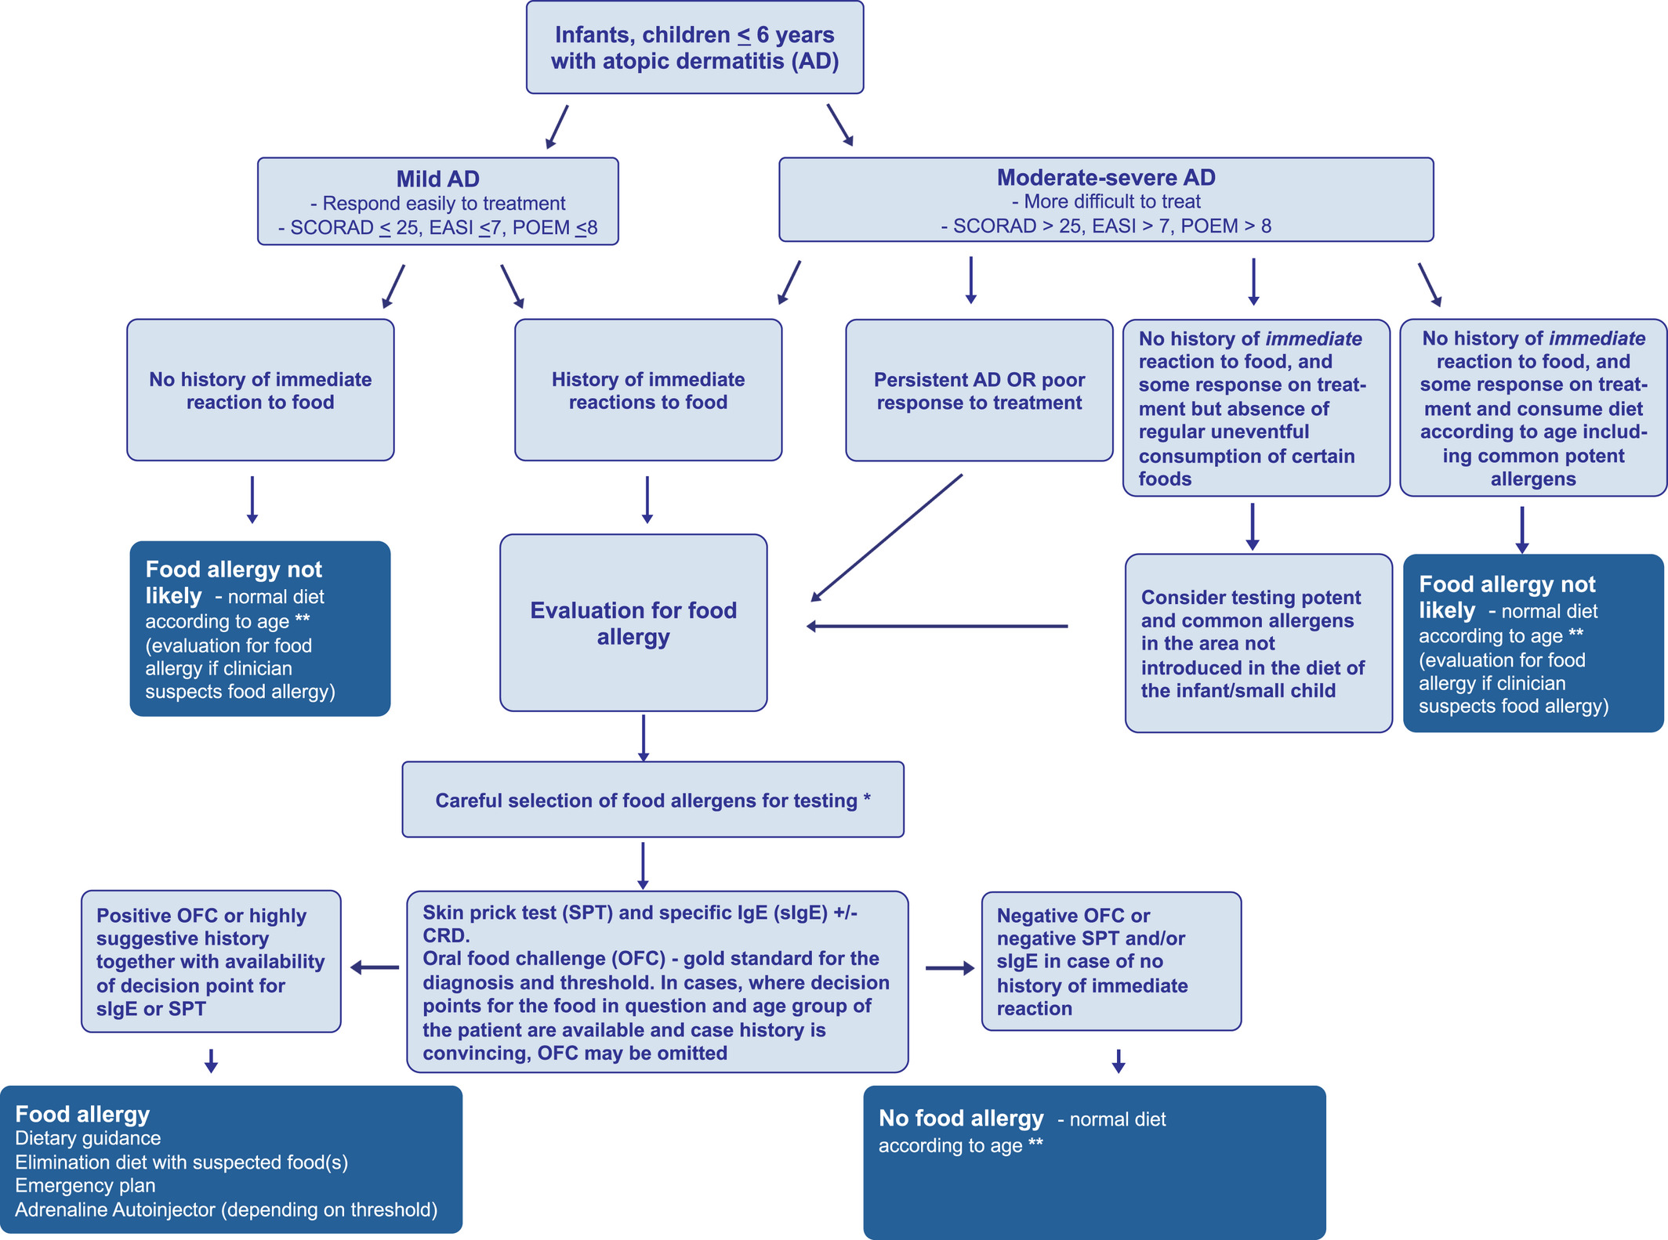
When and how to evaluate for immediate type food allergy in children with atopic dermatitis
Charlotte G. Mortz, George du Toit, Kirsten Beyer, Carsten Bindslev-Jensen, Knut Brockow, et al.
Allergy, Volume: 76, Issue: 12, Pages: 3845-3848, First published: 22 June 2021, DOI: (10.1111/all.14982)
Notes:
Algorithm: When and how to evaluate for immediate (IgE‐mediated) food allergy in children with atopic dermatitis. *A careful medical and dietary history of the infant/child is mandatory prior to selecting the allergens to be tested. The history seeks to determine possible allergenic triggers for the patient as well as common food allergens that have been introduced in the diet. Testing will then aim to confirm suspected allergens as being clinically relevant especially if the history is equivocal as well as to allow for safe dietary expansion if other common allergens, relevant to the patient's geographic location, not yet been eaten. ** Consider food allergy prevention strategies
IF THIS IMAGE HAS BEEN PROVIDED BY OR IS OWNED BY A THIRD PARTY, AS INDICATED IN THE CAPTION LINE, THEN FURTHER PERMISSION MAY BE NEEDED BEFORE ANY FURTHER USE. PLEASE CONTACT WILEY'S PERMISSIONS DEPARTMENT ON PERMISSIONS@WILEY.COM OR USE THE RIGHTSLINK SERVICE BY CLICKING ON THE 'REQUEST PERMISSIONS' LINK ACCOMPANYING THIS ARTICLE. WILEY OR AUTHOR OWNED IMAGES MAY BE USED FOR NON-COMMERCIAL PURPOSES, SUBJECT TO PROPER CITATION OF THE ARTICLE, AUTHOR, AND PUBLISHER.

