Slide 1
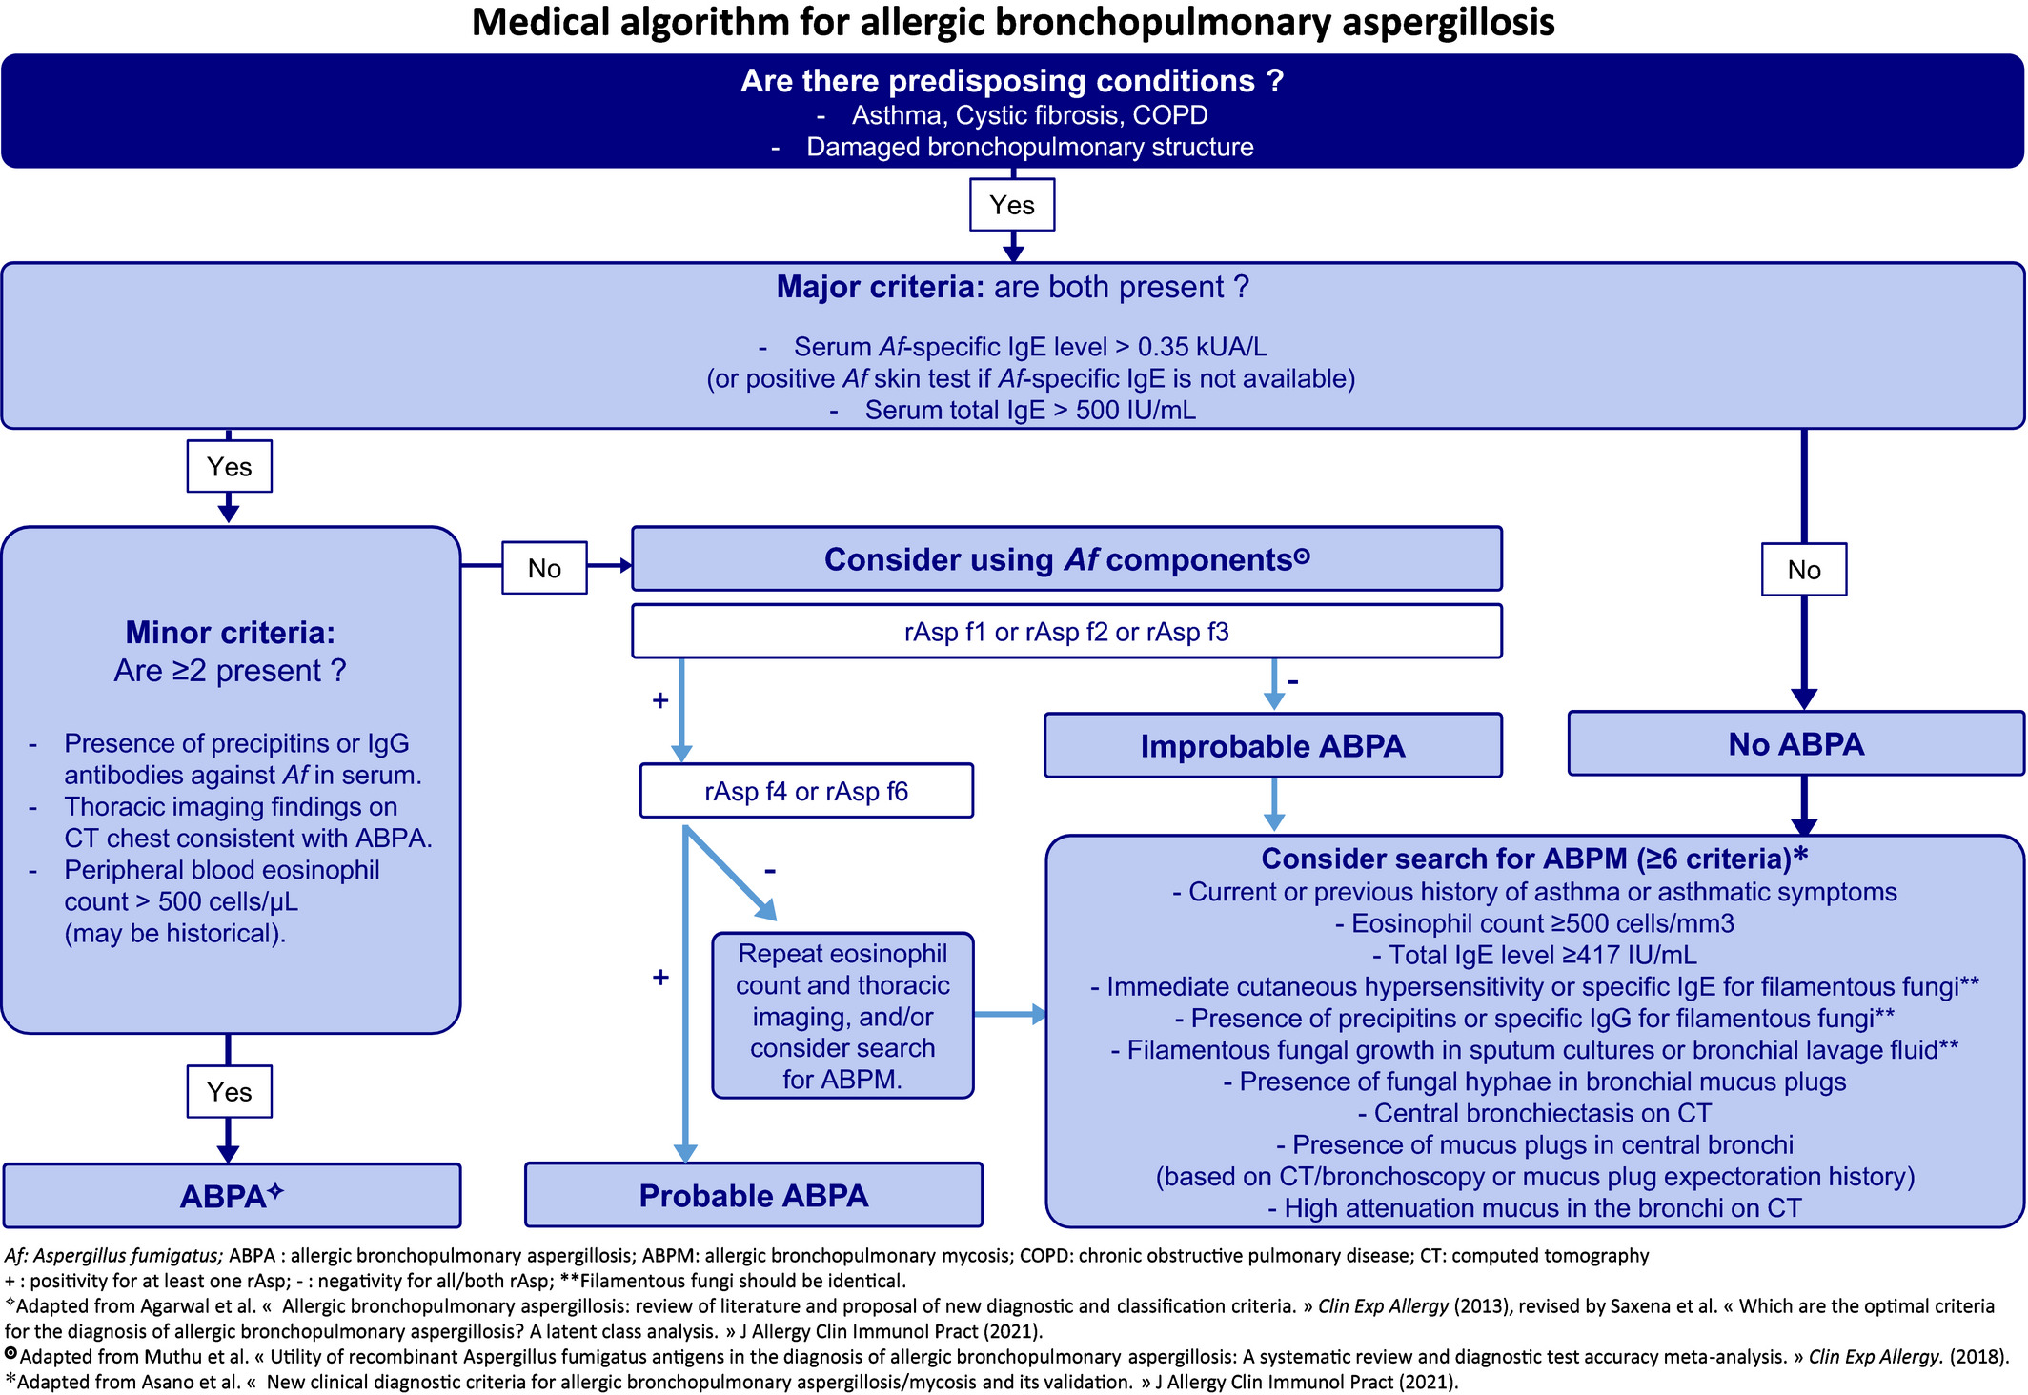
Medical algorithm: Aspergillus fumigatus components in the diagnosis of allergic bronchopulmonary aspergillosis
Raphael Lukaszewicz, Guillaume Mahay, Olivier Boyer, Jérémie Martinet
Allergy, Volume: 77, Issue: 1, Pages: 327-330, First published: 12 July 2021, DOI: (10.1111/all.15001)
Notes:
Medical algorithm for allergic bronchopulmonary aspergillosis (ABPA)
IF THIS IMAGE HAS BEEN PROVIDED BY OR IS OWNED BY A THIRD PARTY, AS INDICATED IN THE CAPTION LINE, THEN FURTHER PERMISSION MAY BE NEEDED BEFORE ANY FURTHER USE. PLEASE CONTACT WILEY'S PERMISSIONS DEPARTMENT ON PERMISSIONS@WILEY.COM OR USE THE RIGHTSLINK SERVICE BY CLICKING ON THE 'REQUEST PERMISSIONS' LINK ACCOMPANYING THIS ARTICLE. WILEY OR AUTHOR OWNED IMAGES MAY BE USED FOR NON-COMMERCIAL PURPOSES, SUBJECT TO PROPER CITATION OF THE ARTICLE, AUTHOR, AND PUBLISHER.

