Slide 1
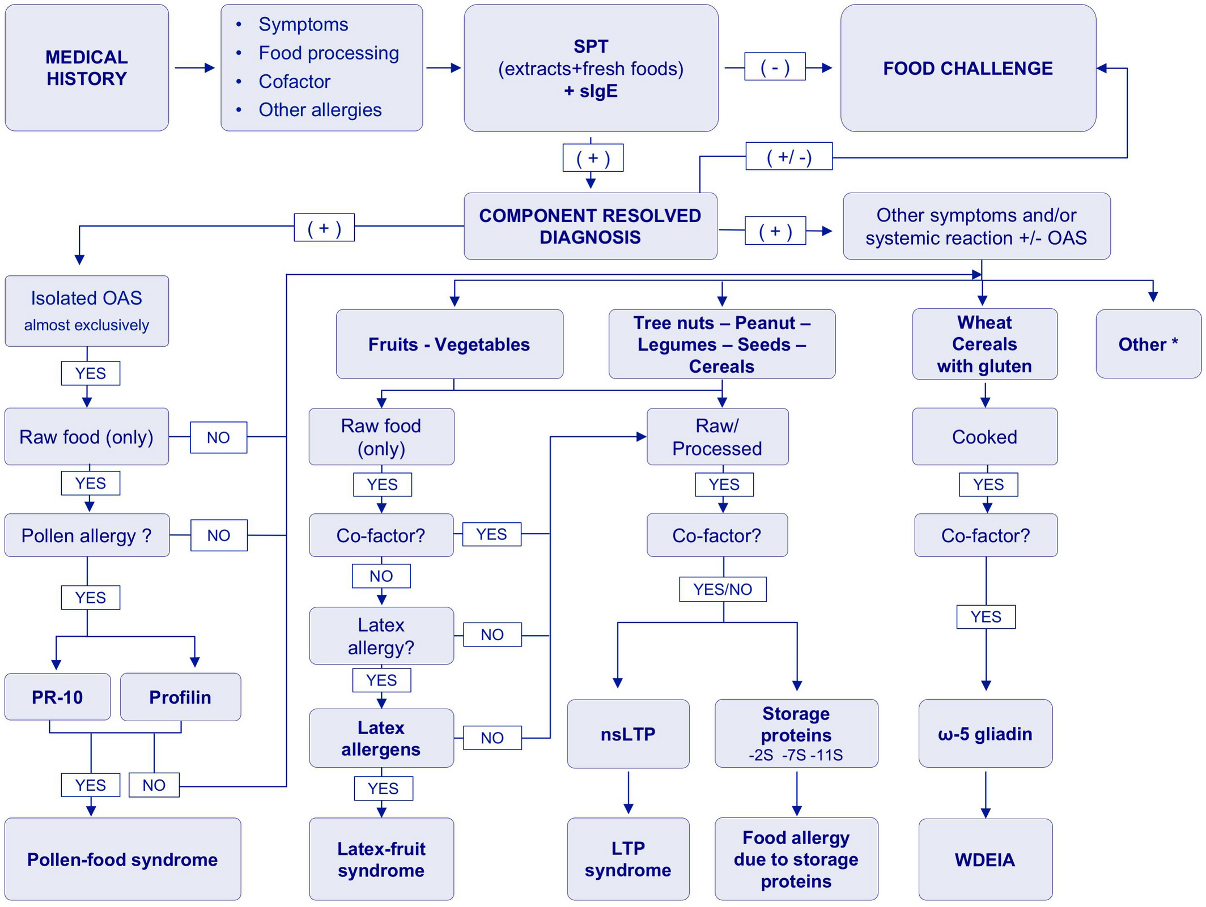
Medical algorithm: Diagnosis of plant food allergy
Rosialzira N. Vera-Berrios, Natalia P. Freundt-Serpa, Montserrat Fernández-Rivas
Allergy, Volume: 77, Issue: 2, Pages: 698-704, First published: 06 August 2021, DOI: (10.1111/all.15037)
Notes:
Algorithm for plant food allergy diagnosis. BAT, basophil activation test; CRD, component‐resolved diagnosis; nsLTP, non‐specific lipid transfer proteins; OAS, oral allergy symptoms; sIgE, specific IgE; SPT, skin prick tests; WDEIA, wheat dependent exercise‐induced anaphylaxis. Reported latex allergens involved in latex‐fruit syndrome: Hev b 6 has significant cross‐reactivity with chitinases in banana, avocado, and chestnut; Hev b 5 has homology to Act d 11 in kiwi; Hev b 7 has homology to patatin protein of the Solanaceae family; due to their high cross‐reactivity with plant foods Hev b 8 (profilin) and Hev b 12 (nsLTP) may be relevant. *Other: Gibberellin‐regulated protein, peamaclein, is a peach allergen Pru p 7 involved in peach allergy in areas with high Cupressus tree pollen exposure; Act d 1 (actinidin) is involved in reactions (frequently systemic) to kiwi in patients monosensitized to this fruit; thaumatin‐like proteins have been described as minor fruit allergens, especially in apple and kiwi, but their clinical relevance is not established; Oleosins have been identified in nuts and seeds and may be associated with severe reactions, but under‐represented in diagnostic extracts due to their lipophilic nature4
IF THIS IMAGE HAS BEEN PROVIDED BY OR IS OWNED BY A THIRD PARTY, AS INDICATED IN THE CAPTION LINE, THEN FURTHER PERMISSION MAY BE NEEDED BEFORE ANY FURTHER USE. PLEASE CONTACT WILEY'S PERMISSIONS DEPARTMENT ON PERMISSIONS@WILEY.COM OR USE THE RIGHTSLINK SERVICE BY CLICKING ON THE 'REQUEST PERMISSIONS' LINK ACCOMPANYING THIS ARTICLE. WILEY OR AUTHOR OWNED IMAGES MAY BE USED FOR NON-COMMERCIAL PURPOSES, SUBJECT TO PROPER CITATION OF THE ARTICLE, AUTHOR, AND PUBLISHER.

