Slide 1
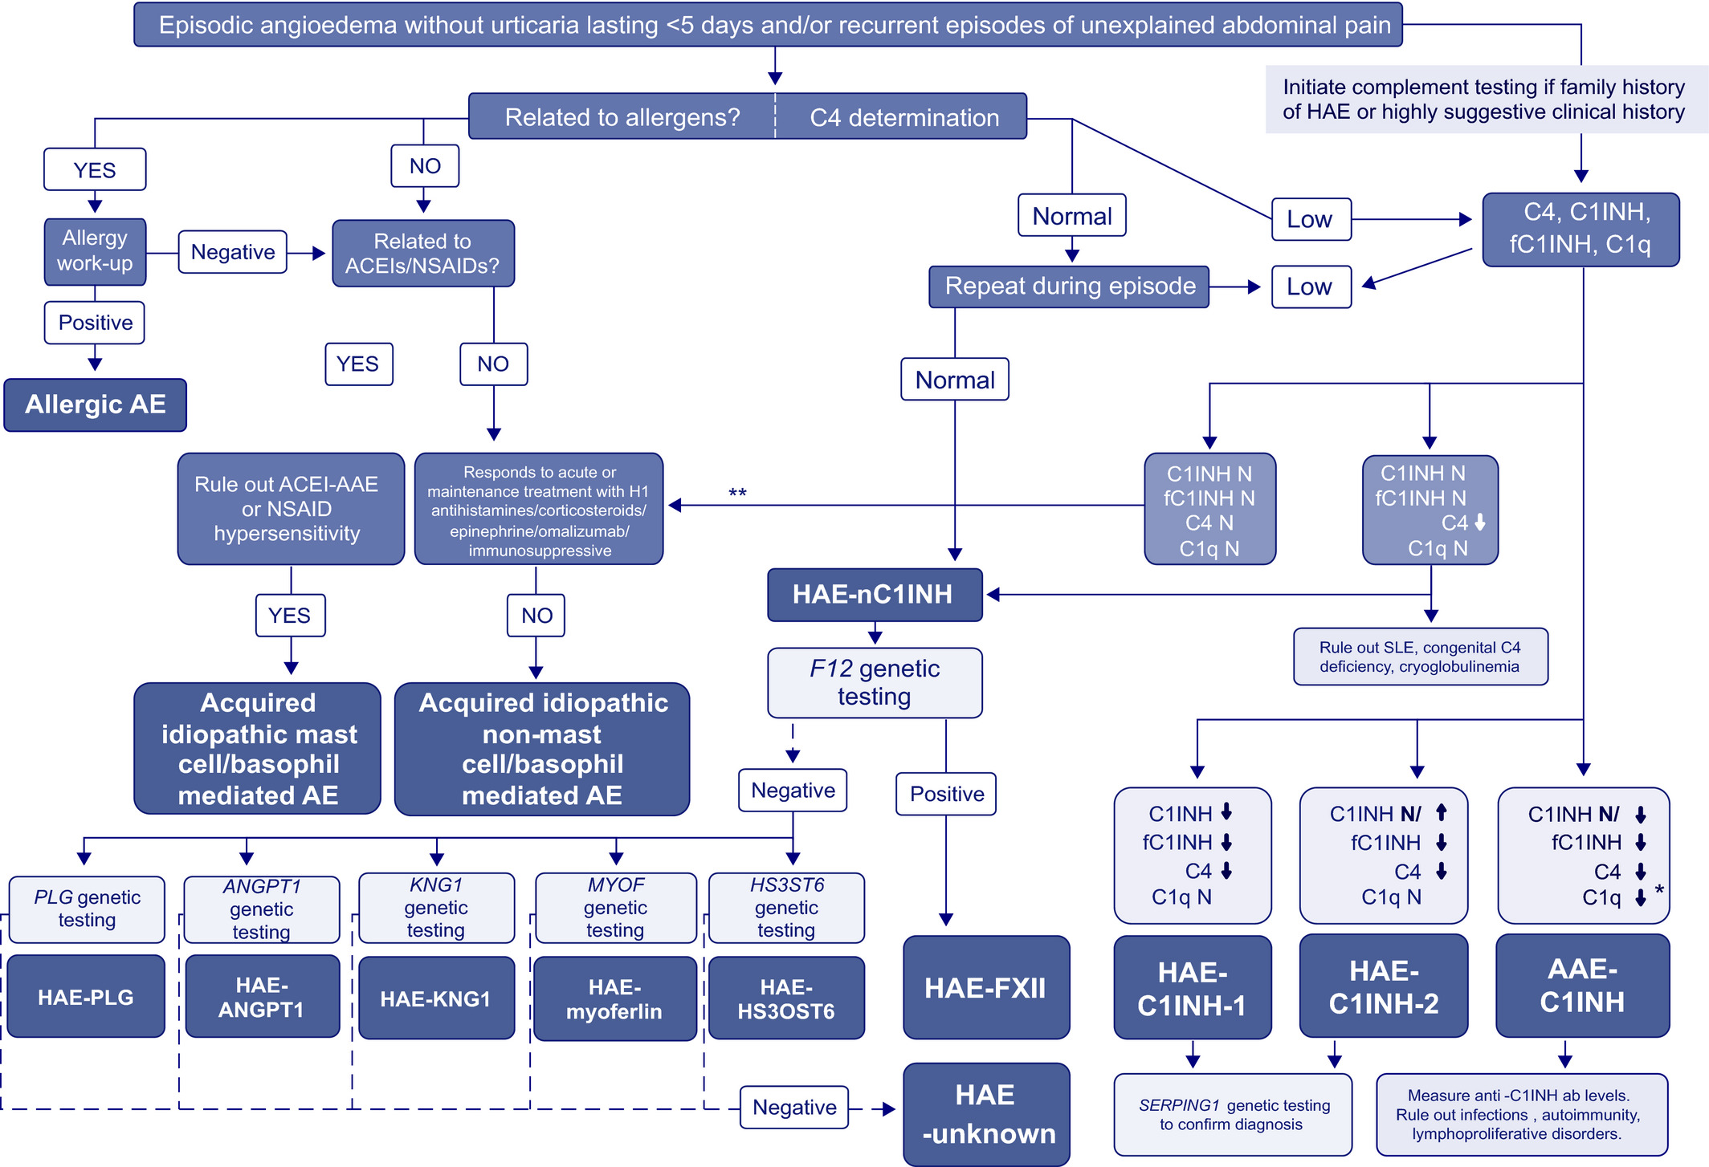
Medical algorithm: Management of C1 inhibitor hereditary angioedema
Teresa Caballero, Rosario Cabañas, María Pedrosa
Allergy, Volume: 77, Issue: 3, Pages: 1060-1063, First published: 29 September 2021, DOI: (10.1111/all.15115)
Notes:
Diagnostic algorithm for hereditary angioedema due to C1‐inhibitor deficiency. When a patient suffers from episodic angioedema lasting fewer than 5 days and/or recurrent episodes of unexplained abdominal pain, any possible relationship to allergens must be identified and studied. Similarly, reactions triggered by drugs (NSAIDs, ACEIs) should also be analyzed. The response to acute or maintenance treatment with H1‐antihistamines, corticosteroids, epinephrine, omalizumab, and immunosuppressives aids in the classification of acquired idiopathic angioedema as mast cell/basophil or nonmast cell/basophil mediated angioedema. C4 levels should also be determined in the initial assessment. In cases where there is a family history of HAE or the clinical history is highly suggestive of bradykinin mediated angioedema, the study should begin with a broader assessment of complement factors. As there are cases of HAE‐C1INH with normal C4 levels during asymptomatic periods, C4 determination should be repeated during an episode when clinical suspicion is high. Normal C4 leads to HAE‐nC1INH diagnosis and F12 genetic study should be performed. If a mutation in F12 gene is found, HAE‐FXII diagnosis is established. Other genes involved in HAE‐nC1INH should be studied in case the F12 gene study is negative. If C4 is low, C1INH, fC1INH, and C1q should be determined and HAE‐C1INH type 1/2 or AAE‐C1INH is diagnosed depending on the combined results. SERPING1 genetic testing can be used to confirm an HAE‐C1INH diagnosis, especially if a de novo mutation is suspected. If AAE‐C1INH is suspected, determination of antiC1INH autoantibodies should be performed, where available. Work‐up recommendations could vary according to country availability of diagnostic tests. *There may be cases of HAE‐C1INH with low C1q or AAE‐C1INH with normal C1q. **Although there is a family history of angioedema, if the complement levels are normal, mast‐cell targeted treatment should be tried prior to confirm HAE‐nC1INH diagnosis. Ab, antibodies; AE, angioedema; AAE, acquired angioedema; AAE‐ACEI, angiotensin‐converting enzyme inhibitors induced acquired angioedema; ACEIs, angiotensin converting enzyme inhibitors; ANGPT1, angiopoietin‐1; C1INH, antigenic C1 inhibitor; fC1INH, functional C1 inhibitor activity; HAE, hereditary angioedema; HAE‐C1INH, hereditary angioedema due to C1‐inhibitor deficiency; HAE‐nC1INH, hereditary angioedema without C1 inhibitor deficiency; HS3OST6, heparan sulfate‐glucosamine 3‐O‐sulfotransferase 6; KNG1, kininogen 1; NSAIDs, nonsteroidal anti‐inflammatory drugs; PLG, plasminogen; SLE, systemic lupus erythematosus
IF THIS IMAGE HAS BEEN PROVIDED BY OR IS OWNED BY A THIRD PARTY, AS INDICATED IN THE CAPTION LINE, THEN FURTHER PERMISSION MAY BE NEEDED BEFORE ANY FURTHER USE. PLEASE CONTACT WILEY'S PERMISSIONS DEPARTMENT ON PERMISSIONS@WILEY.COM OR USE THE RIGHTSLINK SERVICE BY CLICKING ON THE 'REQUEST PERMISSIONS' LINK ACCOMPANYING THIS ARTICLE. WILEY OR AUTHOR OWNED IMAGES MAY BE USED FOR NON-COMMERCIAL PURPOSES, SUBJECT TO PROPER CITATION OF THE ARTICLE, AUTHOR, AND PUBLISHER.

