Slide 1
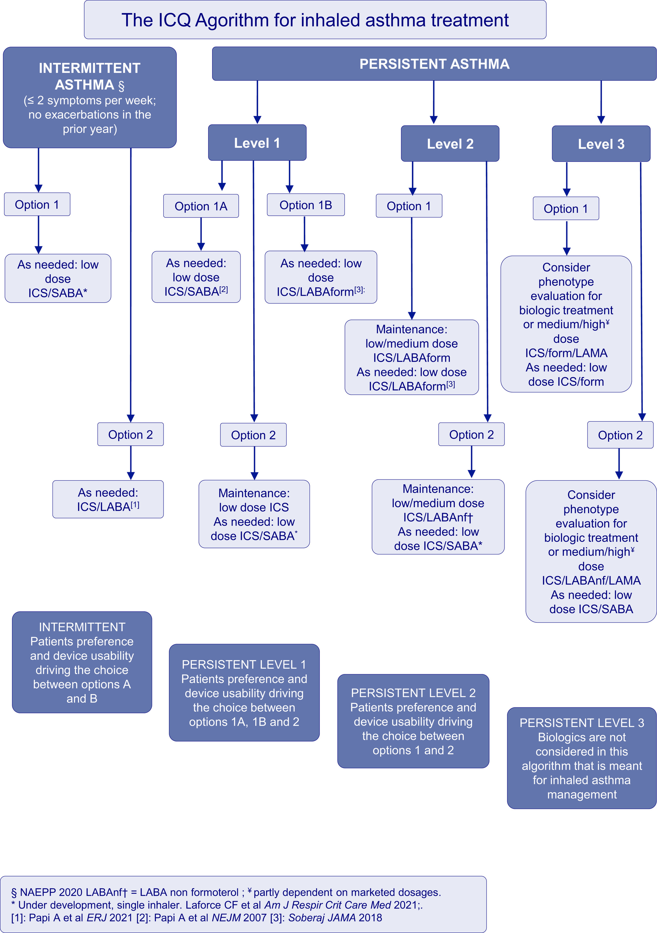
The ICQ asthma algorithm: Inhaled corticosteroid Containing resCUE (ICQ) treatment for present and future asthma management
Alberto Papi,Milos Jesenak,Franco Alfano,Diego G Peroni,Federico Baraldi,Zuzana Diamant
Allergy, Volume: 77, Issue: 4, Pages: 1325-1327, First published: 06 October 2021, DOI: (10.1111/all.15131)
Notes:
The ICQ Agorithm for inhaled asthma treatment
IF THIS IMAGE HAS BEEN PROVIDED BY OR IS OWNED BY A THIRD PARTY, AS INDICATED IN THE CAPTION LINE, THEN FURTHER PERMISSION MAY BE NEEDED BEFORE ANY FURTHER USE. PLEASE CONTACT WILEY'S PERMISSIONS DEPARTMENT ON PERMISSIONS@WILEY.COM OR USE THE RIGHTSLINK SERVICE BY CLICKING ON THE 'REQUEST PERMISSIONS' LINK ACCOMPANYING THIS ARTICLE. WILEY OR AUTHOR OWNED IMAGES MAY BE USED FOR NON-COMMERCIAL PURPOSES, SUBJECT TO PROPER CITATION OF THE ARTICLE, AUTHOR, AND PUBLISHER.

